Slide 1




Montgomery Nursery School
Open House
2025-2026 School Year

Slide 2
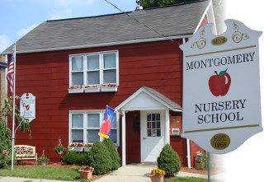
Montgomery Nursery School
Proudly serving the Village of Montgomery and surrounding area for 56 years!

Slide 3
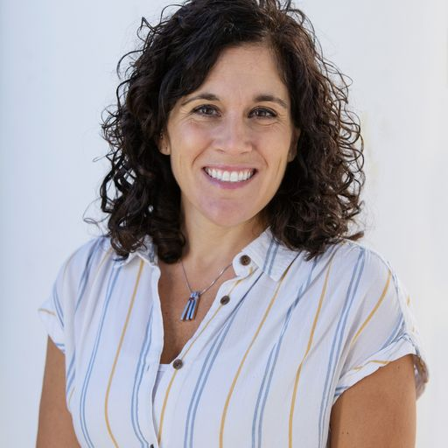
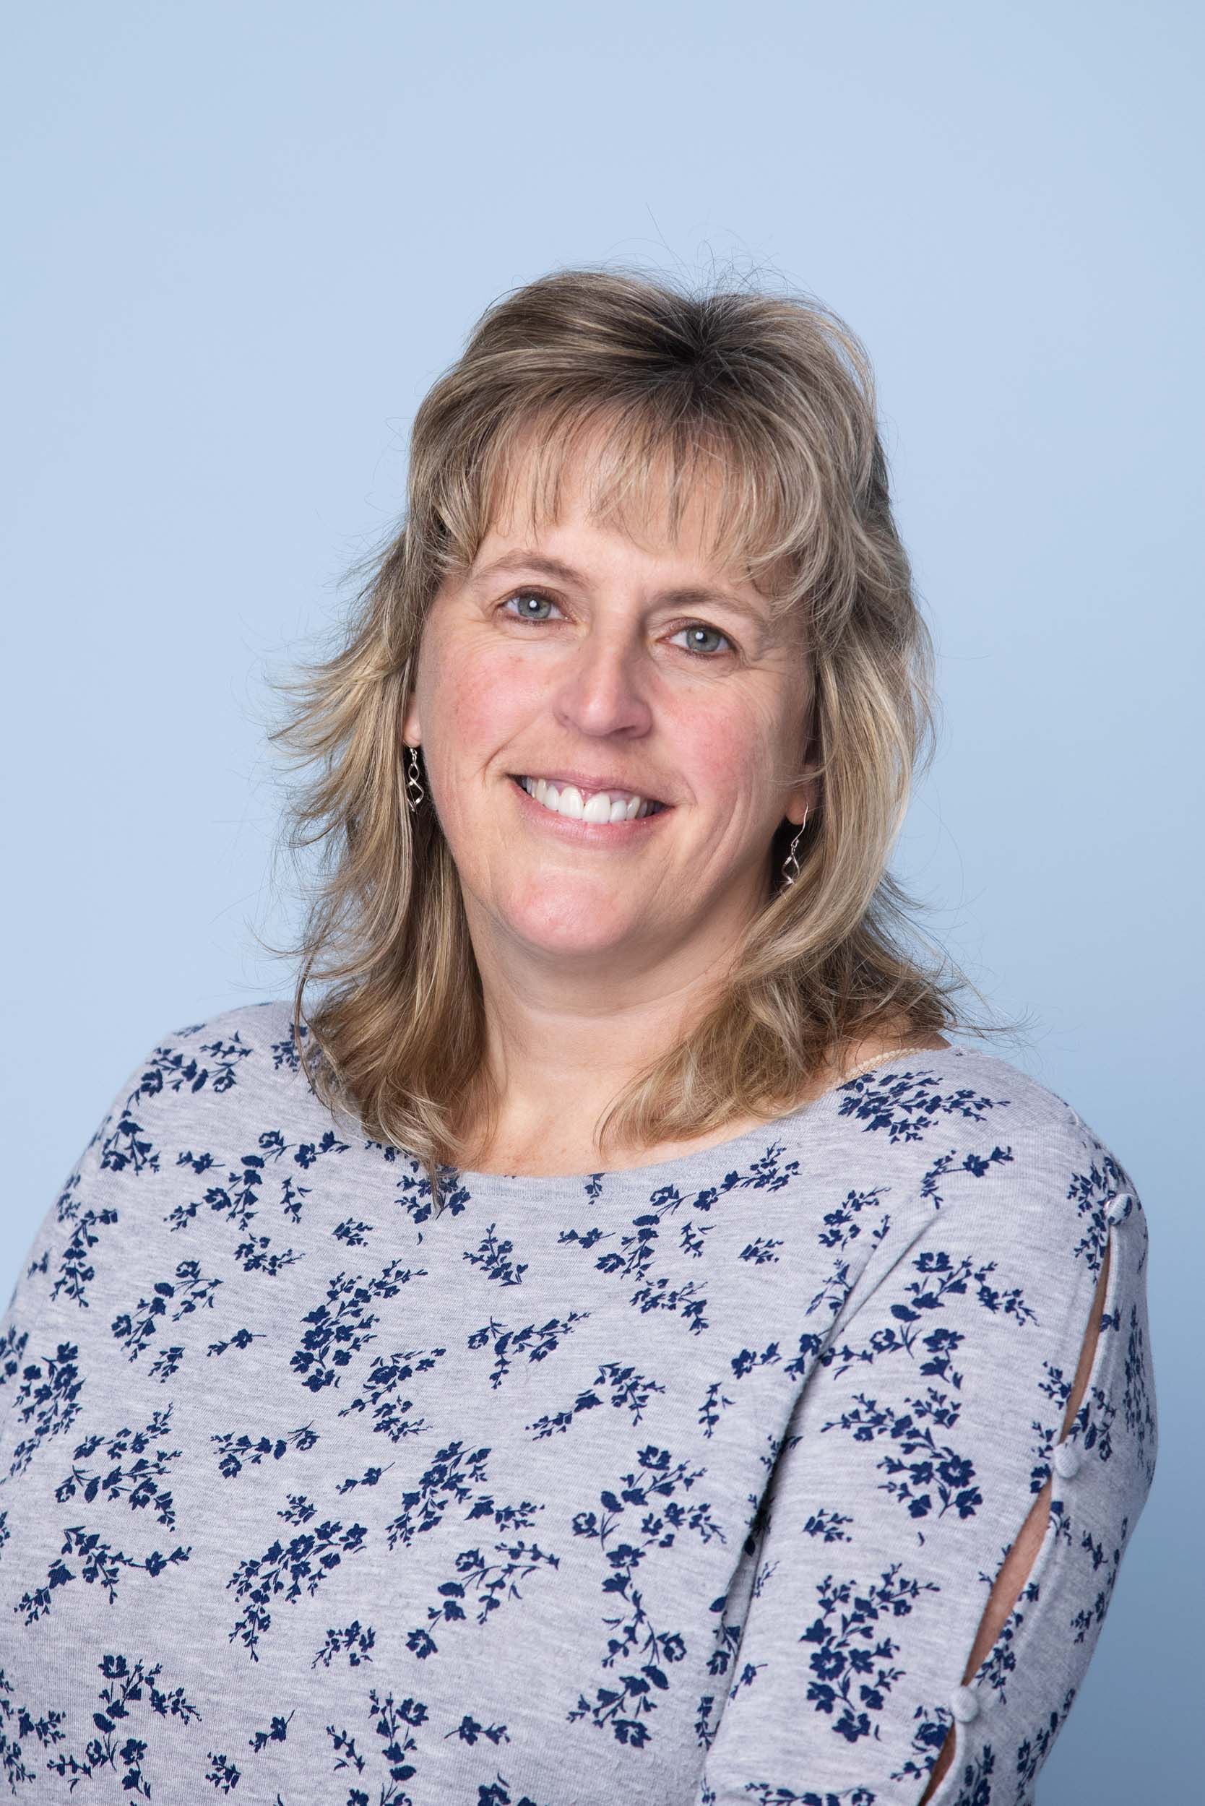
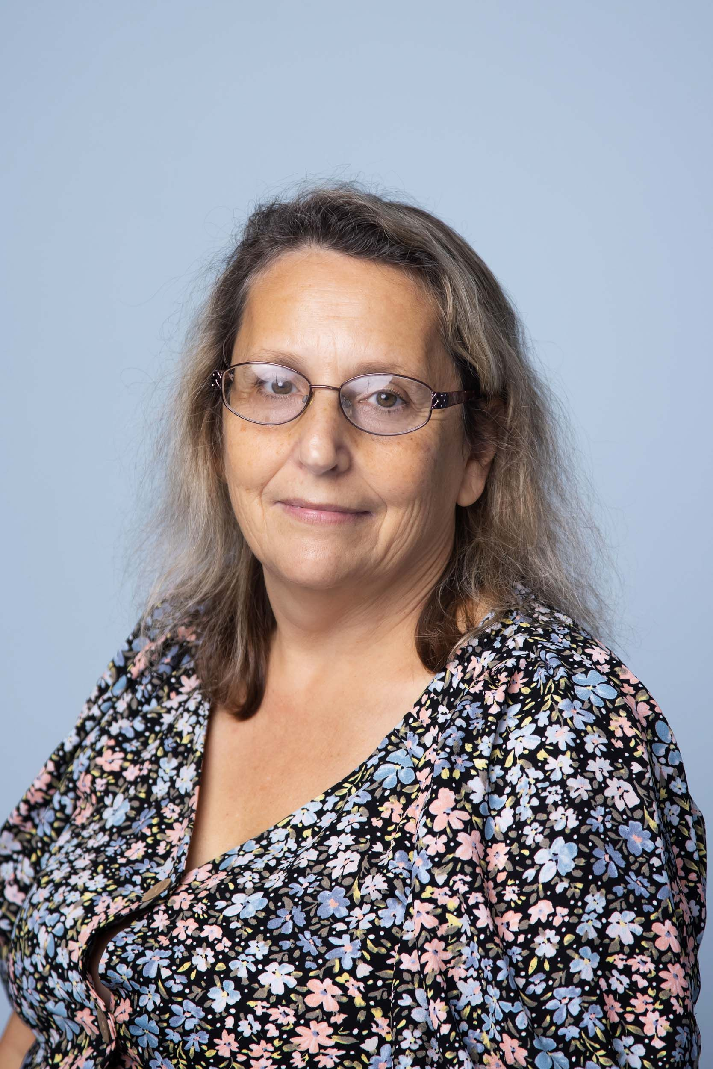
Welcome Parents!
Montgomery Nursery School was incorporated as a non-profit organization in 1967. We received our charter by the State of New York in 1968. Additionally, in 2016 we received our Non-public School license and in 2020 we received our New York State Day Care license.
Our staff are highly trained, experienced and dedicated to our students.
Teachers
  Mrs. Clarke: Full Day Four Year Old Class (UPK)
  Miss Kerri: Half Day Four Year Old Class (UPK)
  Miss Roseann: Three Year Old Class

Slide 4
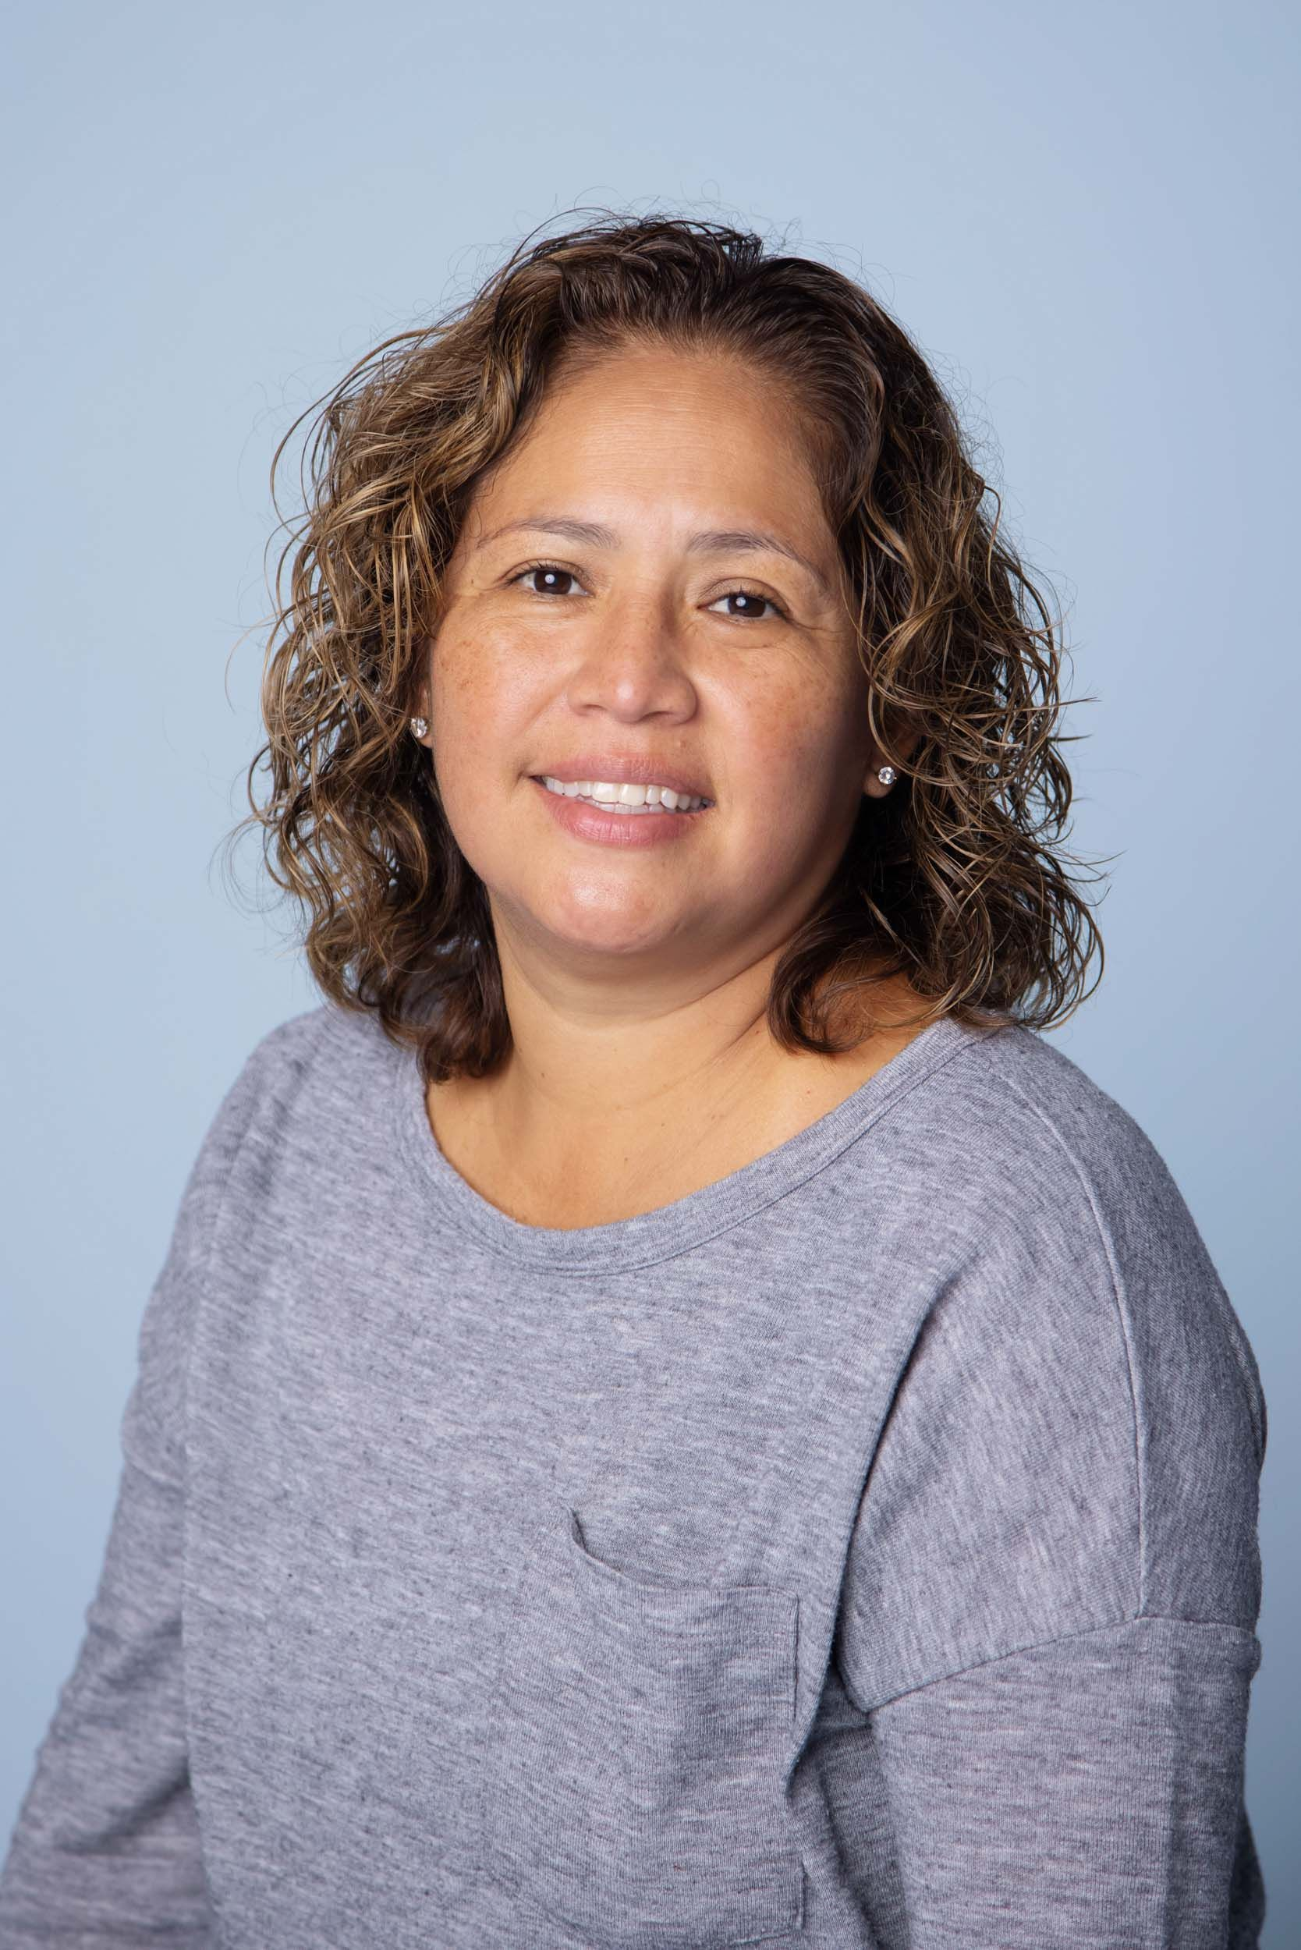
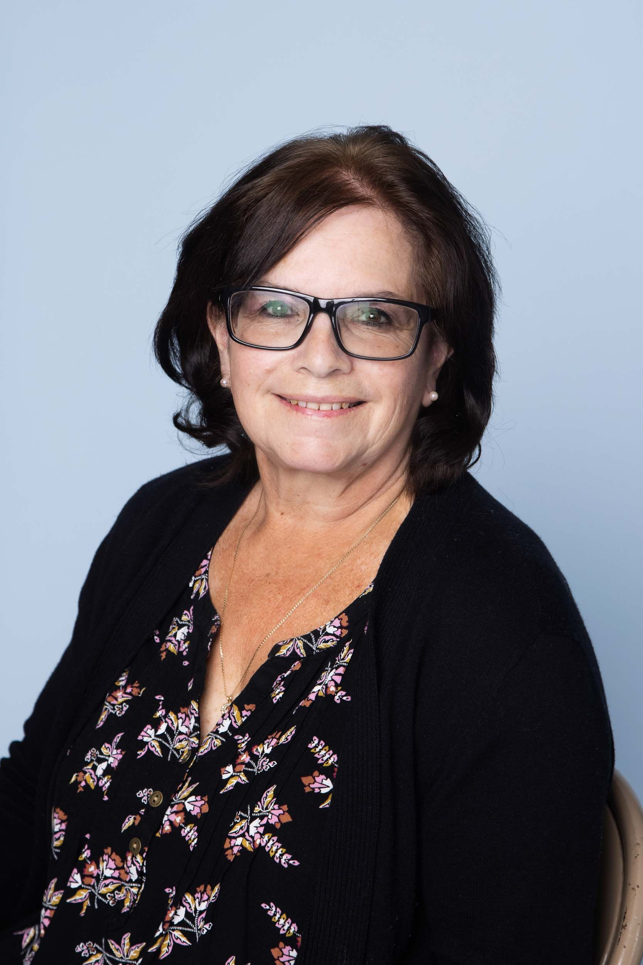
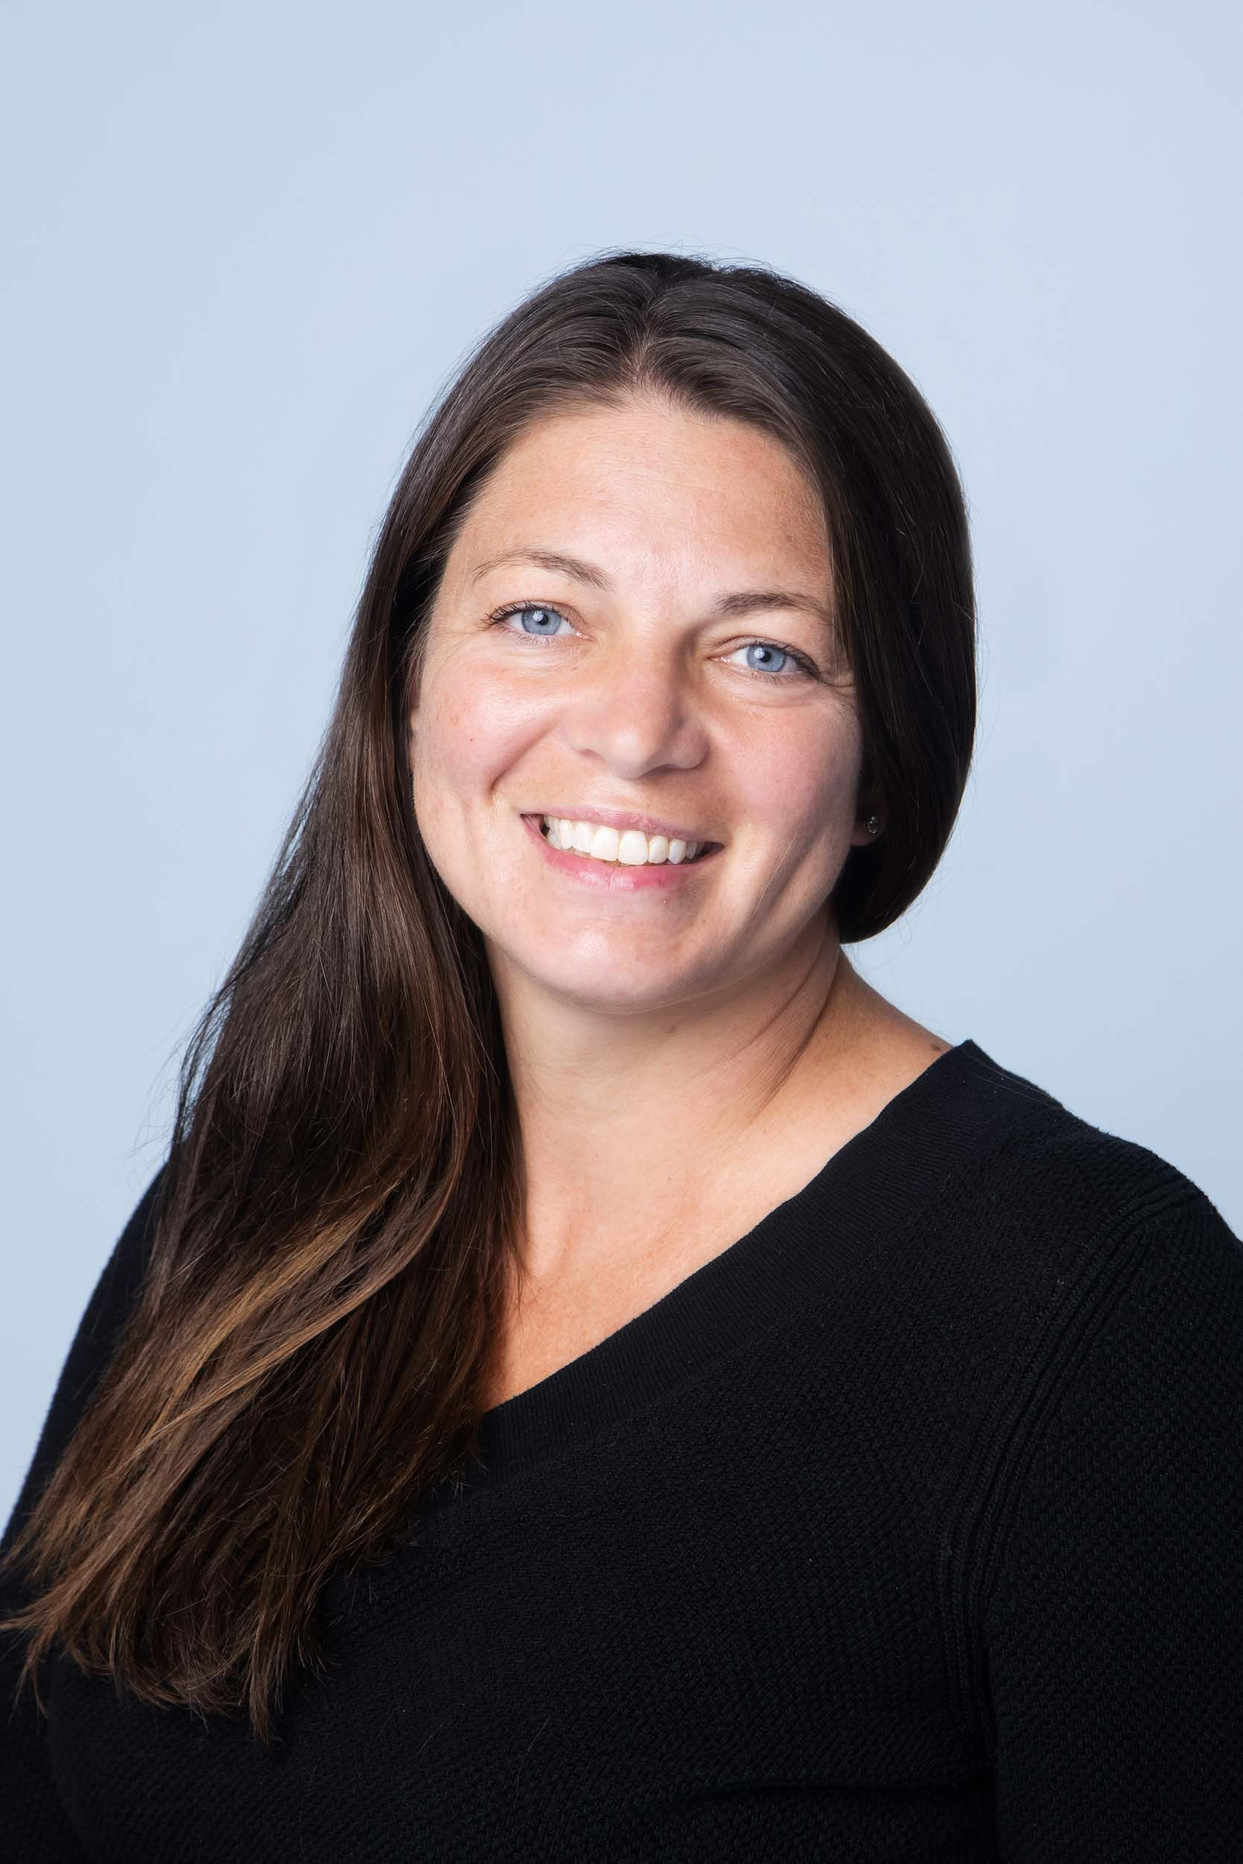
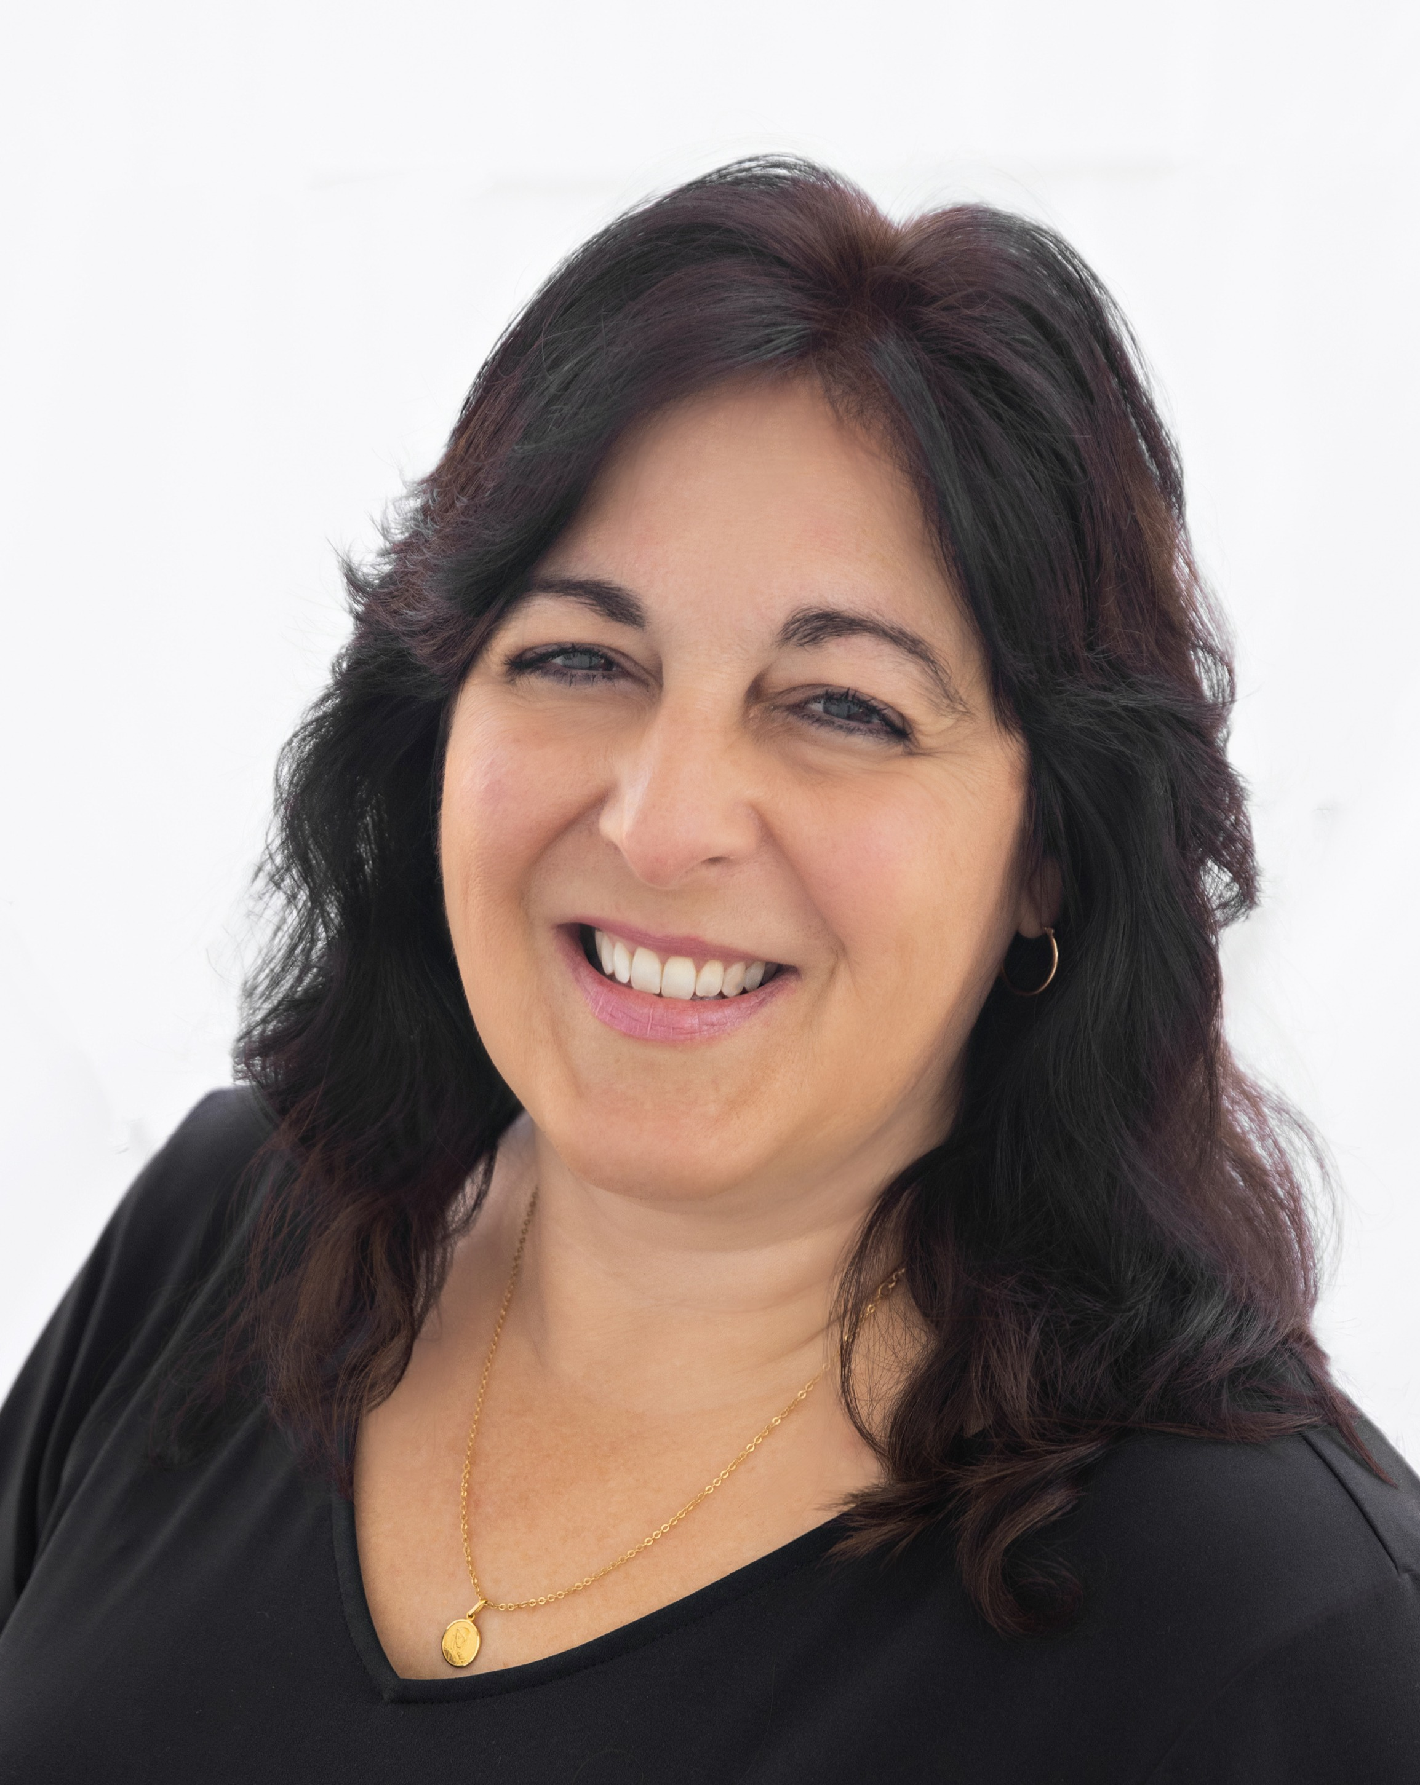
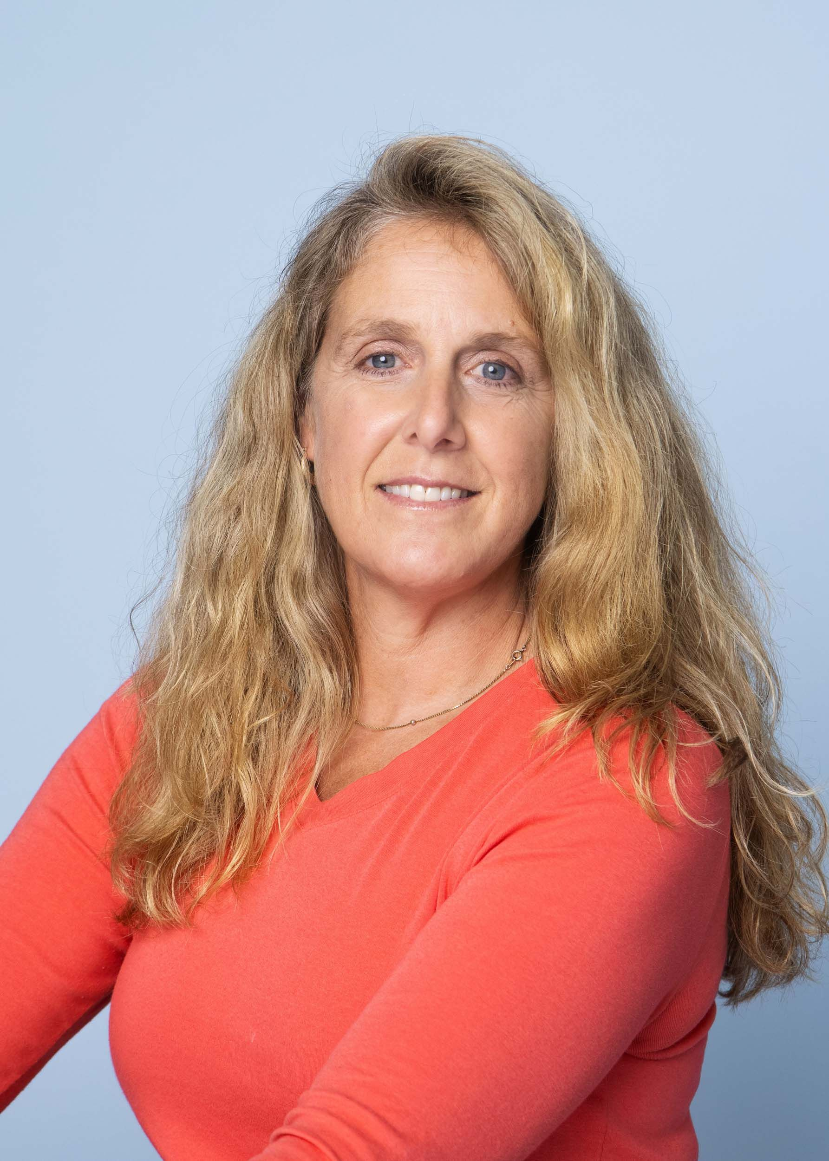
Teacher Aides
Stephanie Gonzalez
Kelly Quinn
Nancy Schoonmaker
Donna Spampinato
Trish Mohr

Slide 5
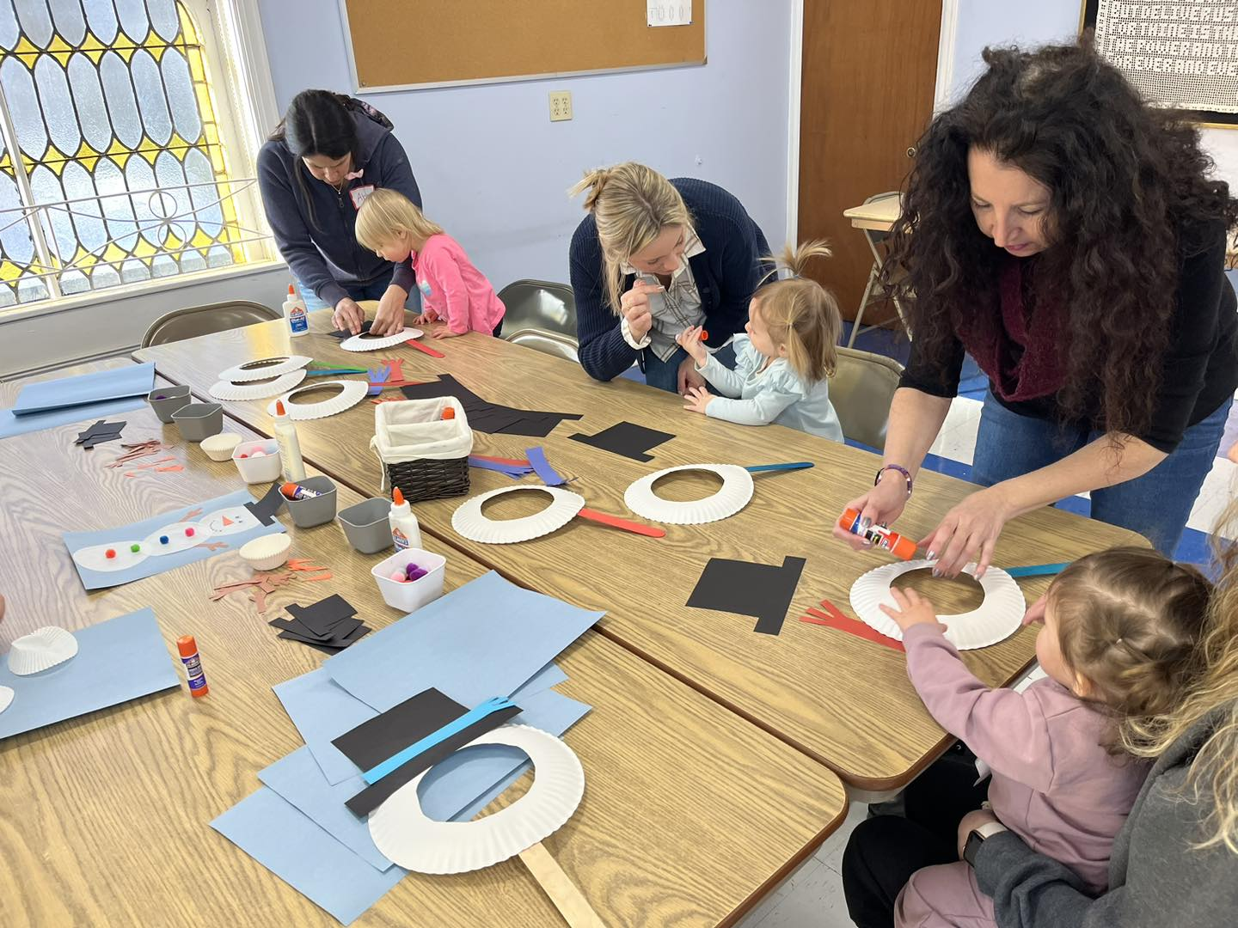
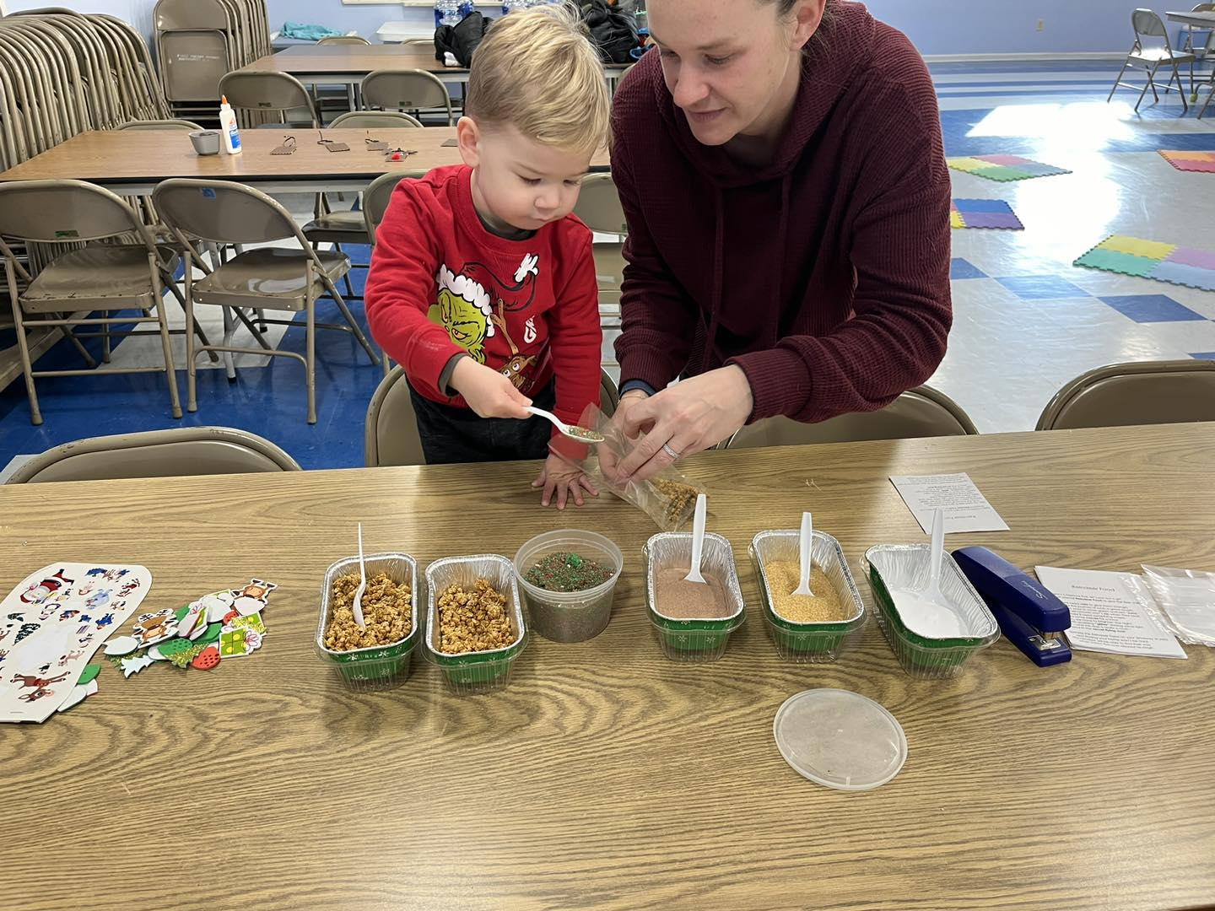
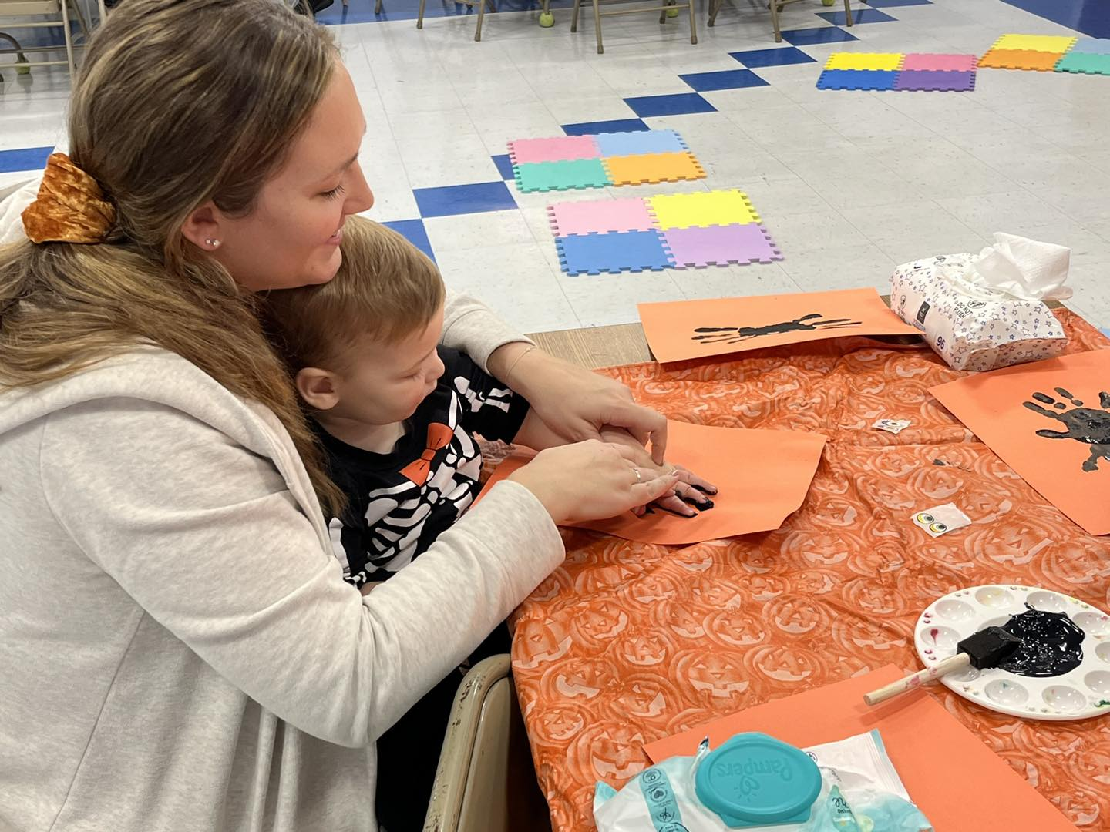
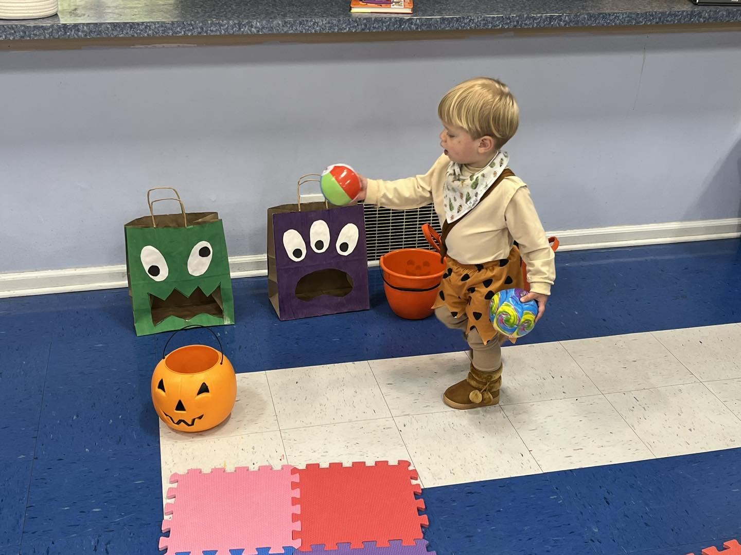
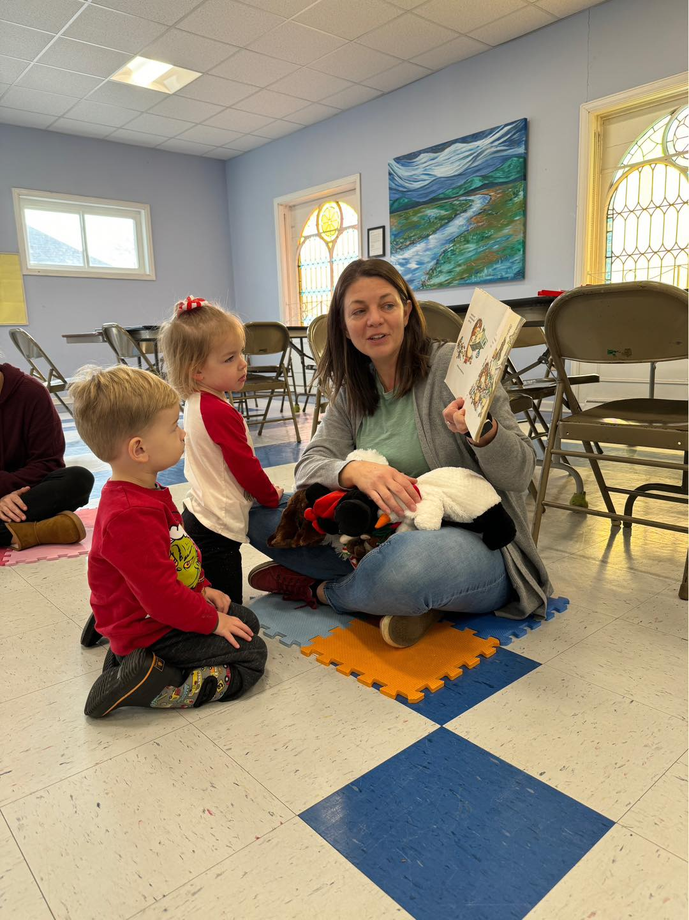
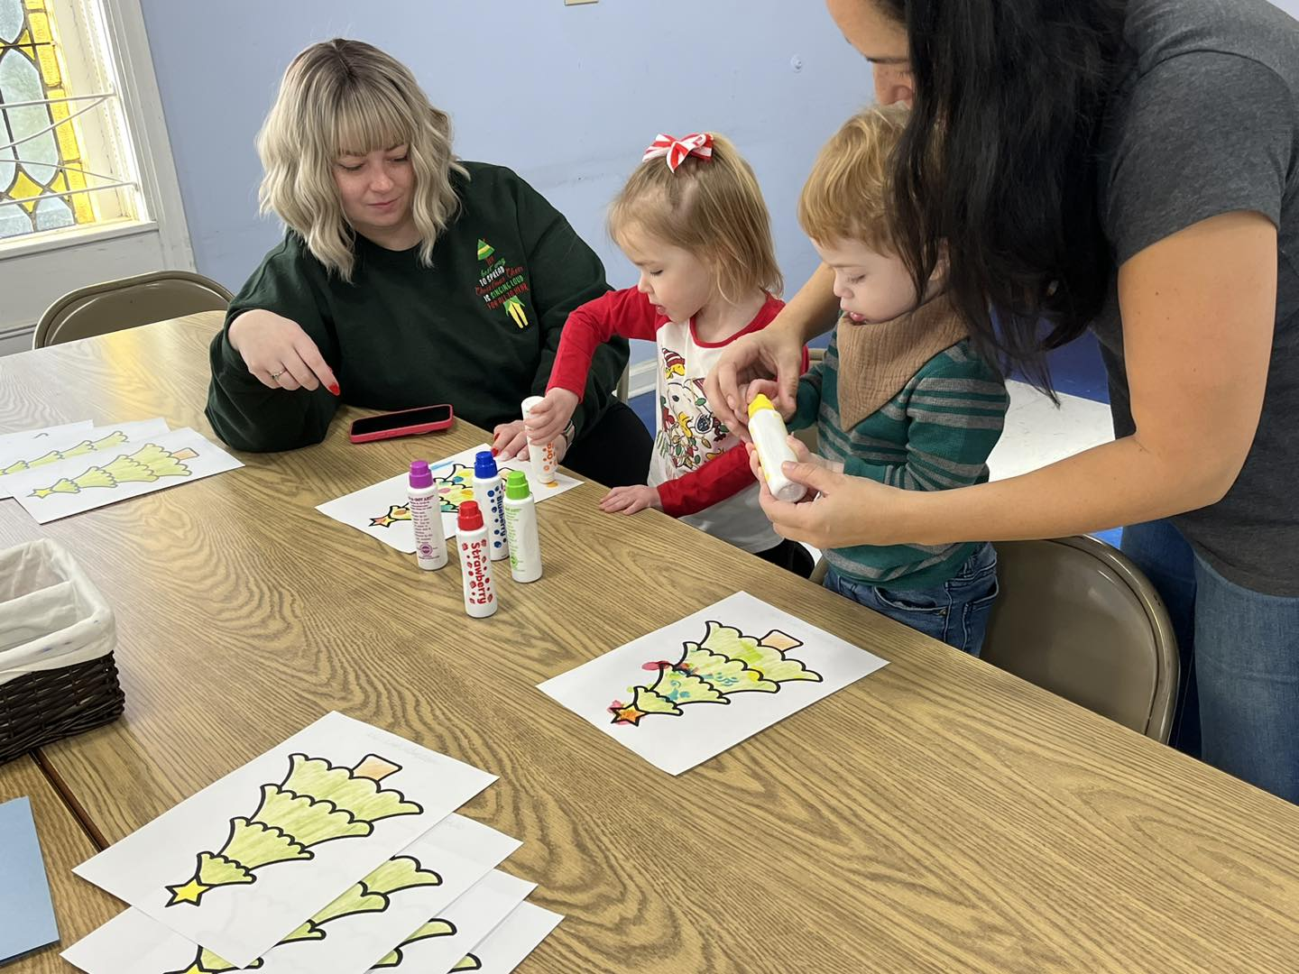
Mommy & Me Class
Mommy and Me class is for children 18 months to three years old and their care giver. This is a great place for your child to develop socially and cognitively at the same time as strengthening bonds with you!
Music, songs, crafts, story time, exercise, books, poems, and special activities!

Slide 6
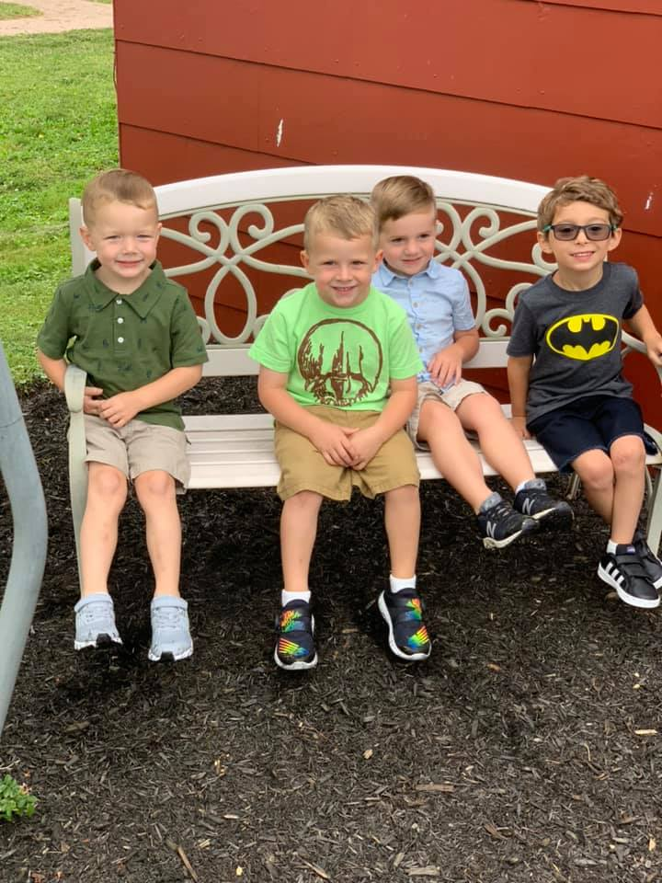
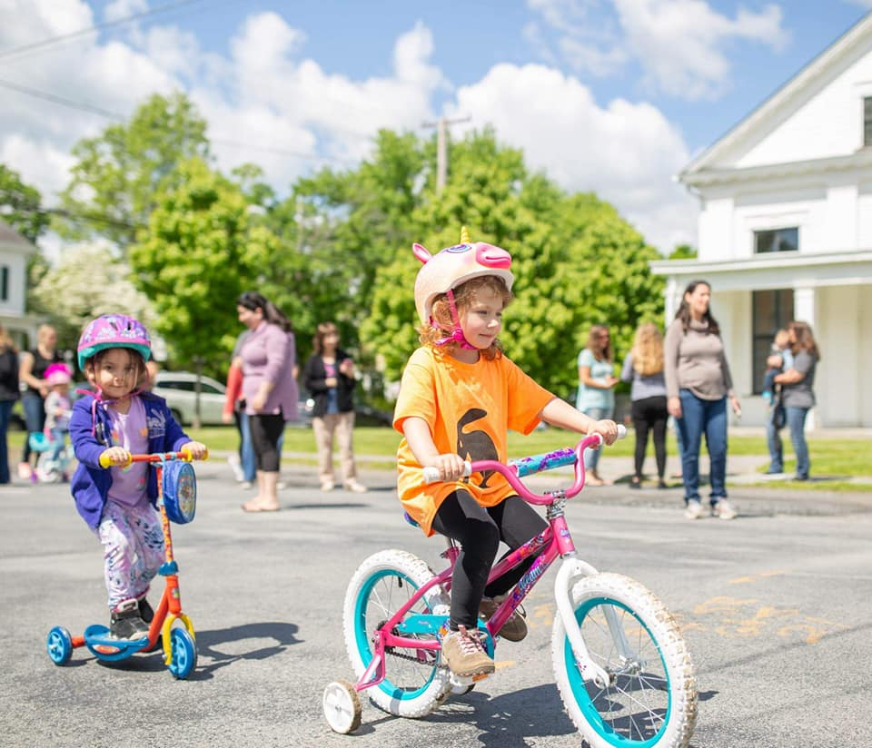
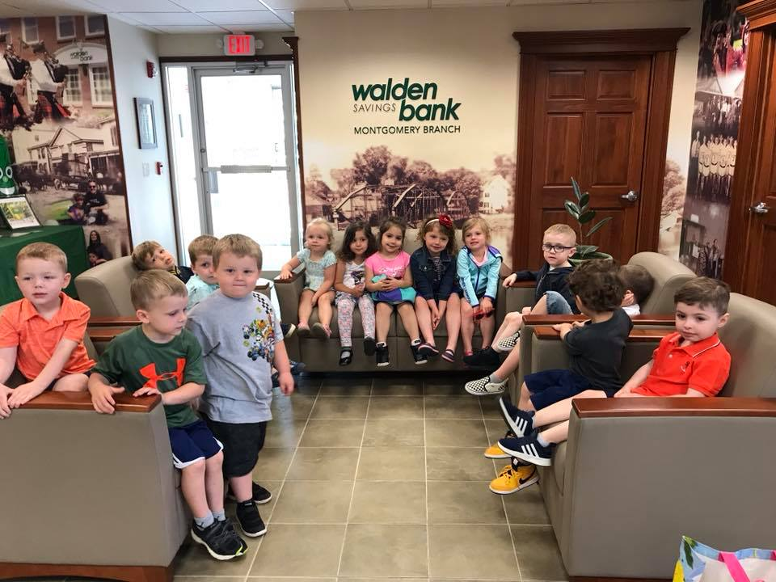
Three Year Old Class
Our three-year-old class is open to students who turn three years old on or before December 1st of the current school year.
Socialization is a strong focus for this class. Skills are woven into the curriculum through routines and activities. Preschool readiness skills such as lining up, taking turns, sharing, listening to others, and using manners appropriately are emphasized throughout the day.
Routines are established that help the children to feel comfortable and in control within their surroundings. Circle time includes jobs for the children, finger plays, songs and discussion about the day’s theme.
Monthly thematic units reinforce basic concepts such as colors, shapes, the numbers one through ten, seasons, and holidays. Arts and crafts activities help to exercise fine motor skills. During monthly cooking activities, measuring ingredients help the children with pre-math skills such as counting.
Story time is a special part of the day and guest readers are welcome. Occasional visits to the local library are always a treat. Gross motor skills are exercised outside at our playground or inside by participating in games and dances. A short period of time is designated to snack times at which mealtime and conversation skills are reinforced.

Slide 7
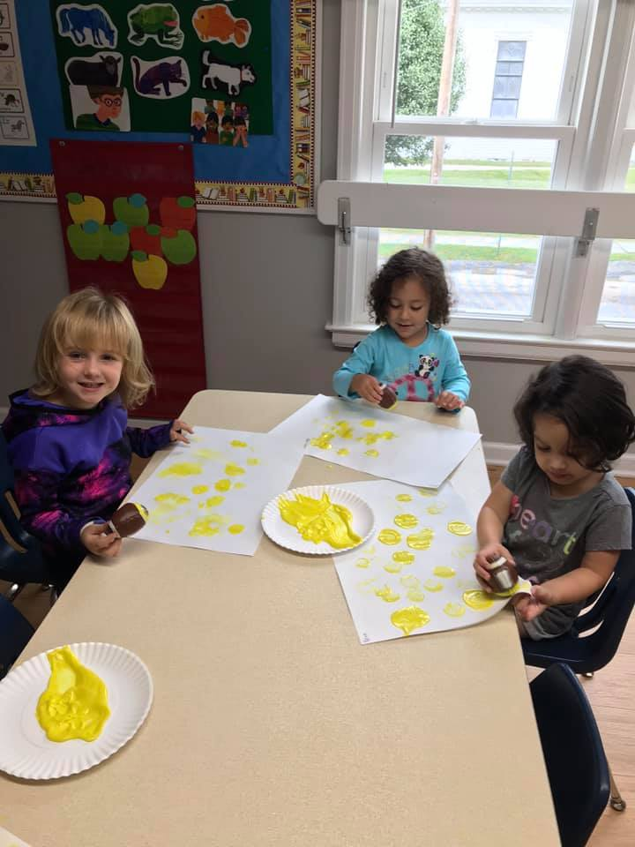
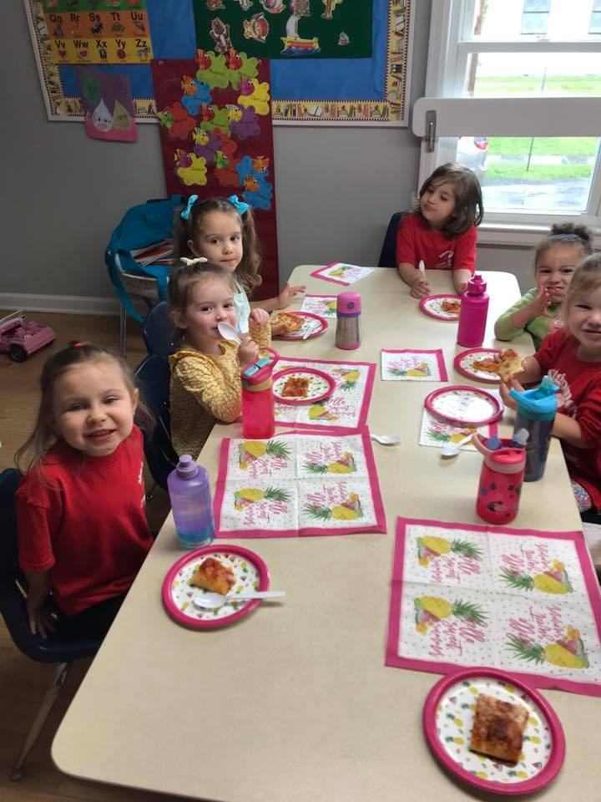
Three Year Old Class
Year at-a-Glance
September January May
Color: Yellow Color: White Number: “9”
Number: “1” Number: “5” Letter M- Mother, May
Letter F – Fall Shape: Rectangle Letter N- Nine, Newspapers
Letter L – Leaves Letter Q- Quilt, Queen Letter W – Walrus, Whale
All about me Letter S- Snow Village Field Trips
Friendship Letter J - January Community Helpers
Family Winter Fun, Five Senses
October
Colors: Orange and Black February June
Number: “2” Color: Pink Number: “10”
Shape: Circle Number: “6” Letter X – X-ray
Letter H – Halloween Shape: Heart Letter Y - Yarn
Letter E – Elephant Letter G- Groundhog Letter Z - Zoo
Fire Prevention Letter D- Dentist Poison Prevention
Nutrition and Dental Health
November
Color: Brown March
Number: “3” Color: Blue
Shape: Square Number: “7”
Letter I – Ice Cream, Igloo Shape: Oval
Letter T – Turkey Letter B- Bear, Balloons
Scissors Introduction Letter P - Pizza
Letter K- Kite
December Windy Weather
Colors: Red and Green
Number: “4” April
Shape: Triangle Color: Purple
Letter C – Candy Cane Number: “8”
Letter U – Unicorn, Umbrella Shape: Diamond
Letter O – Open, Octopus Letter A- April
Holidays Letter R- Rain
Letter V- Violets
Nursery Rhymes, Plants and Insects

Slide 8
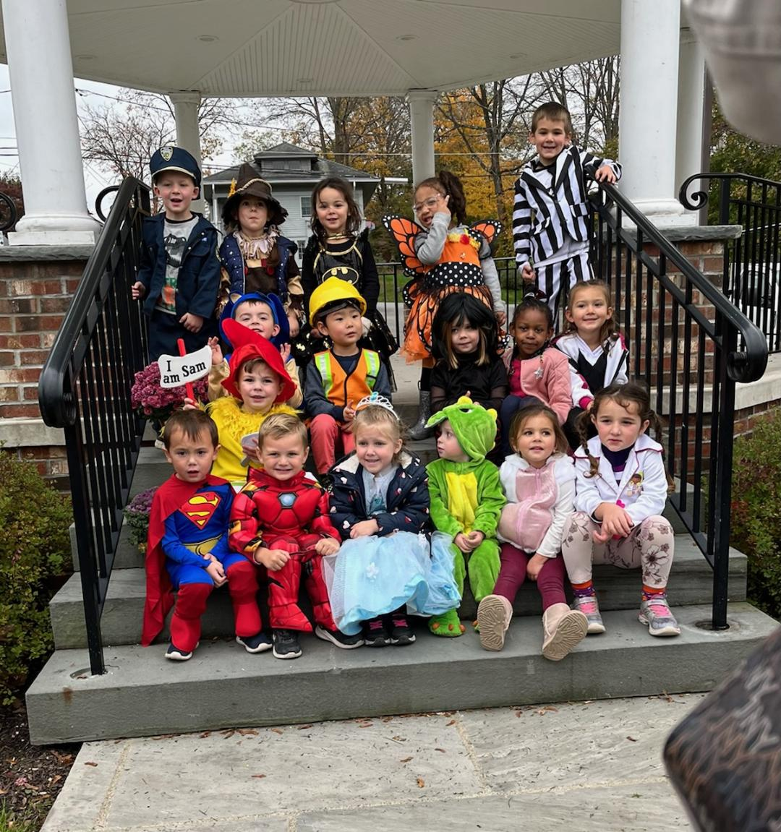
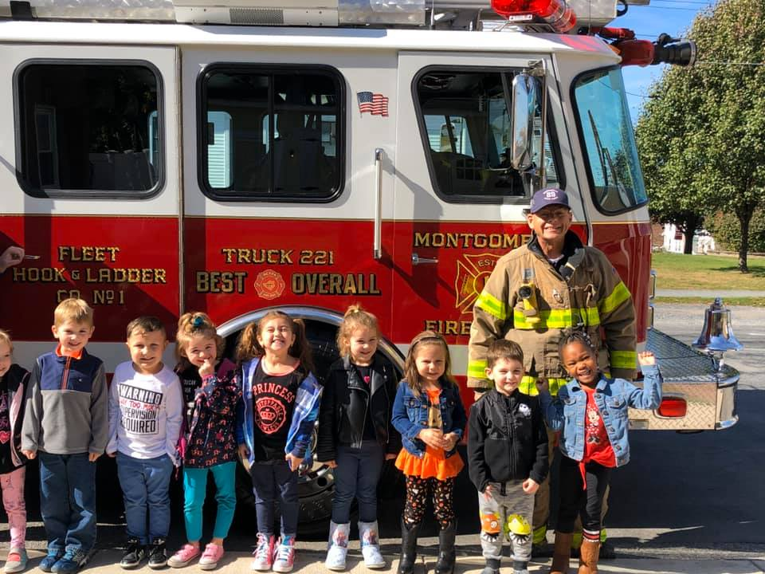
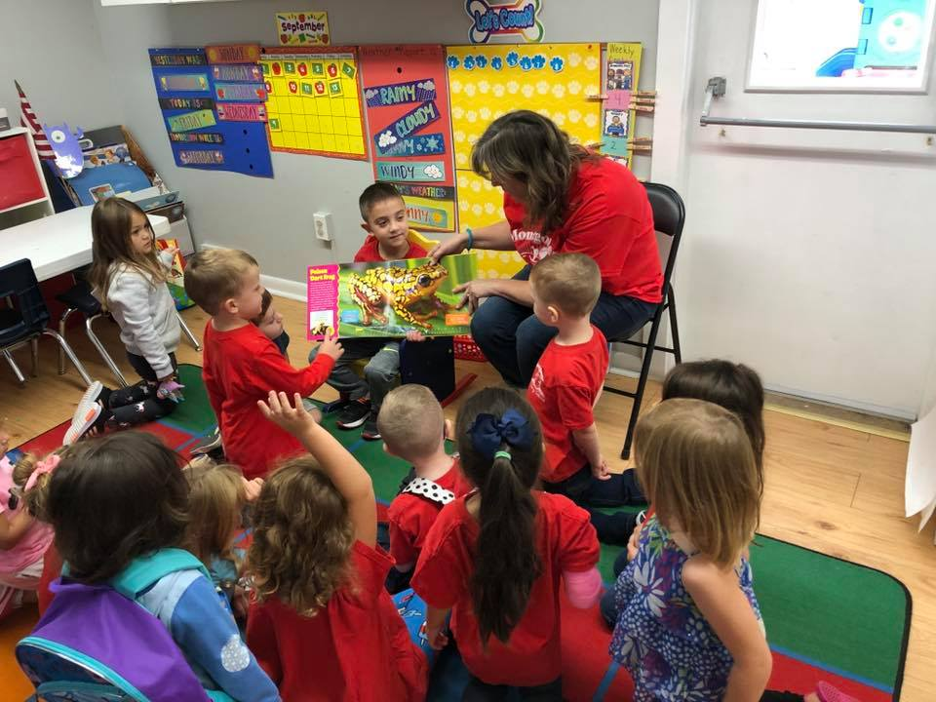
Four Year Old Class (UPK)
Our four-year-old class is open to students who turn four years old on or before December 1 of the current school year.
Montgomery Nursery School firmly believes that each child is a unique individual. We are sensitive to each child’s social, emotional, intellectual, and physical needs. We emphasize Kindergarten readiness by developing both a positive self-esteem and early literacy skills necessary for future tasks such as reading, writing, and mathematics. Montgomery Nursery School’s curriculum is based on New York State curriculum guidelines and our staff maintains a close working relationship with district Kindergarten teachers.
Daily routine, personal and classroom responsibilities are emphasized and encouraged. Our curriculum goals are accomplished through a variety of mediums such as music, exercise, arts & crafts, computers, and field trips. Parent-Teacher conferences are held mid-year along with an individual evaluation “report card”. Graduation ceremonies are held in June.

Slide 9
Half Day UPK Year at-a-Glance
September-Welcome to School
All About Me
Friends/Families
Apples
Letters-M,F,A
Shape-Circle
Color-Red
Numbers-1,2
October- Fall/Leaves/Trees
Fire Safety
Pumpkins
Spiders & Scarecrows
Letters-L,P,T,S
Shape-Rectangle
Color-Orange
Numbers-3,4
November-Dinosaurs
Buildings/Thanksgiving/Being Thankful
Letters-D,Y,B
Shape-Triangle
Color-yellow and brown
Numbers-5,6
December-Gingerbread Men
5 Senses/Christmas/Hanukkah
Letters-G,C
Shape-star
Colors-gold and silver
Numbers-7,8
January-Winter (Snow & Ice)/Animals in Winter/Penguins/Polar Animals
Letters- I,Q,J
Shape-Square
Colors-black and white
Numbers-9,10
February-Shadows/Valentine’s Day/Bears
Letters-V, X, N
Shapes-Heart
Color-Pink
Numbers-11, 12
March-Weather(Lions & Lambs)/St. Patrick’s Day/Spring/Dr. Seuss author study
Letters-U,K,W
Shape-rhombus
Color-green
Numbers-13, 14
April-Easter/Eggs/Reduce, Reuse, Recycle/Trees part 2; Space
Letters-E,O,R
Shapes-oval, octagon
Color-blue
Numbers-15,16
May- Mother’s Day/Flowers/Frog and Butterfly Life Cycle/Zoo/Ocean
Letters-Z, X
Shape-pentagon
Color-purple
Numbers-17, 18
June- Balls/Father’s Day/Summer/Kindergarten
Letters-Review of all letters
Shape-Review
Color-gray
Numbers-19,20

Slide 10
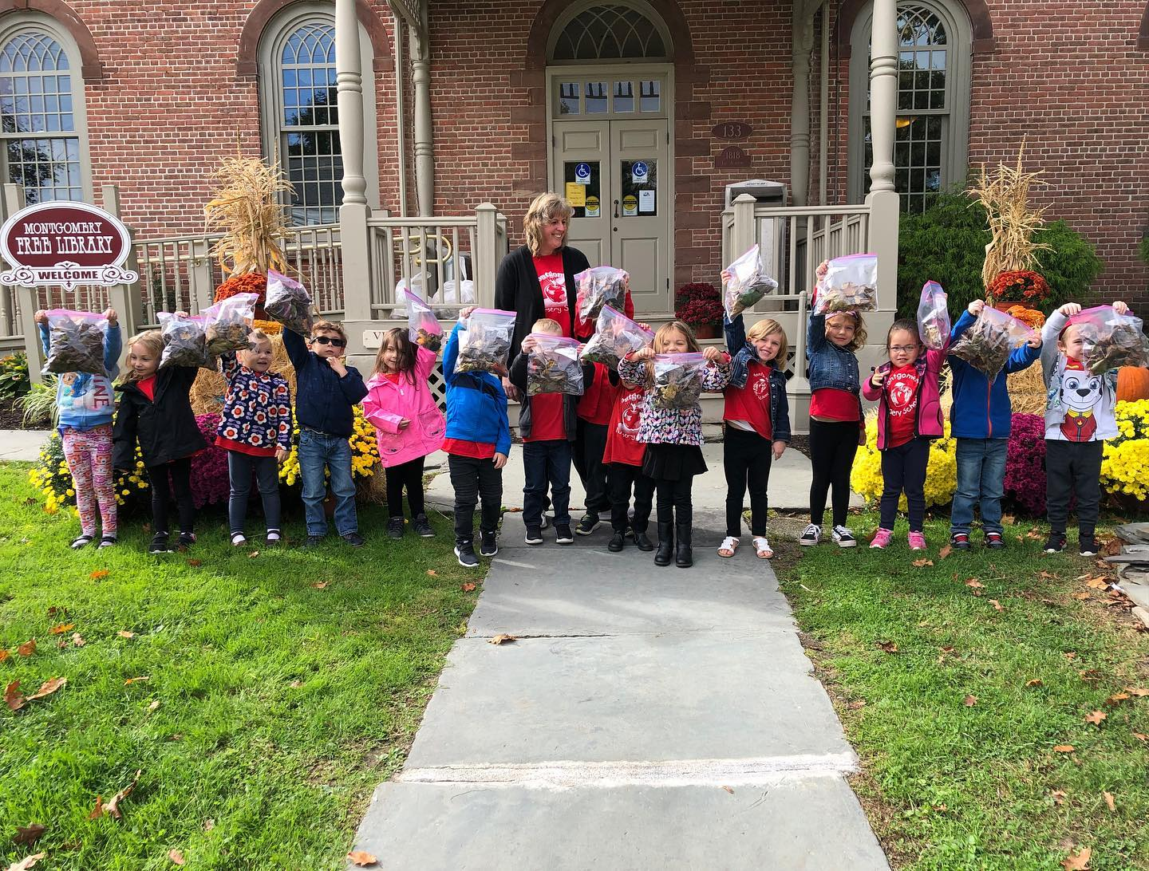
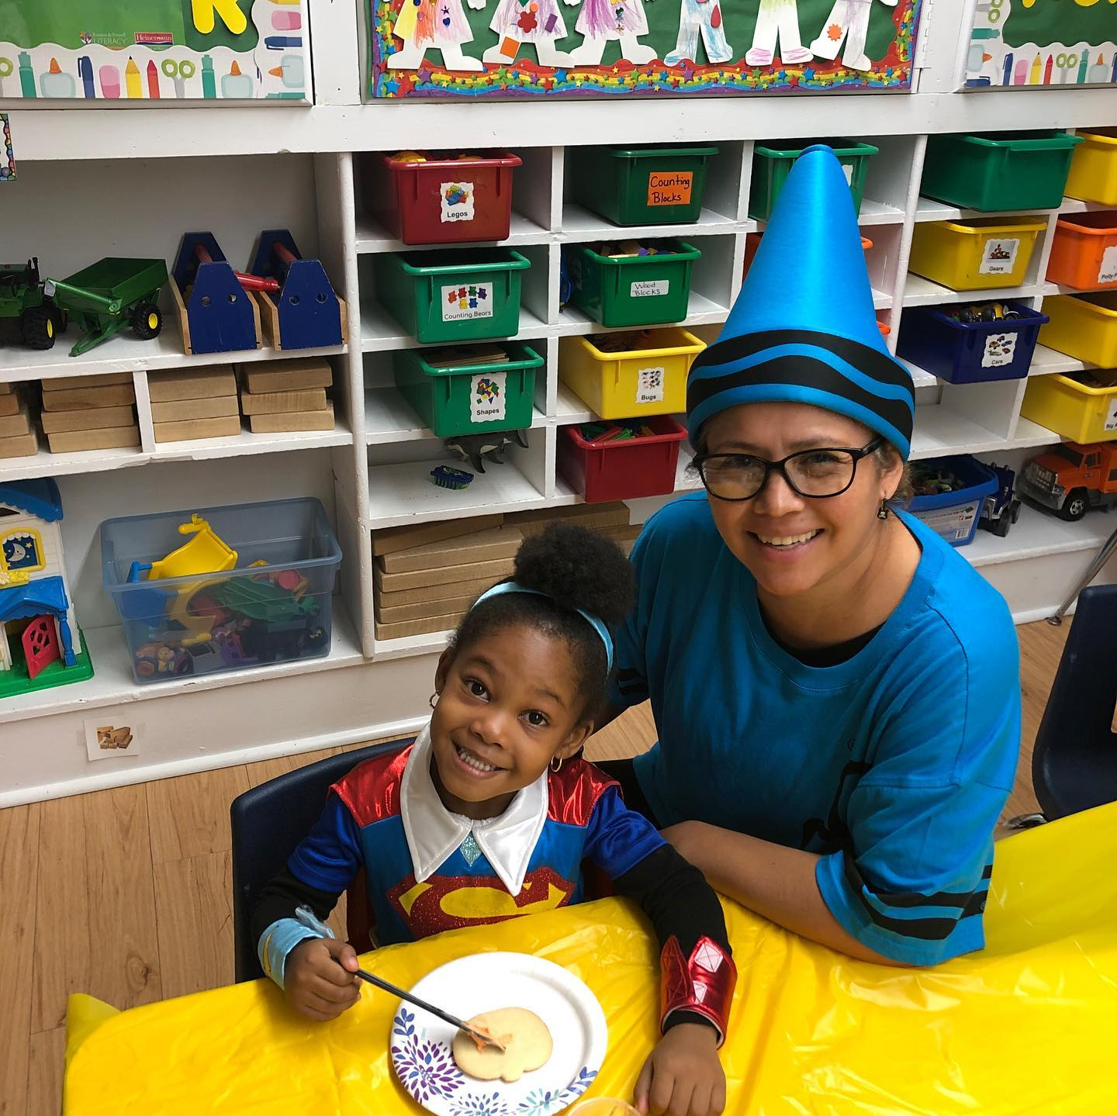
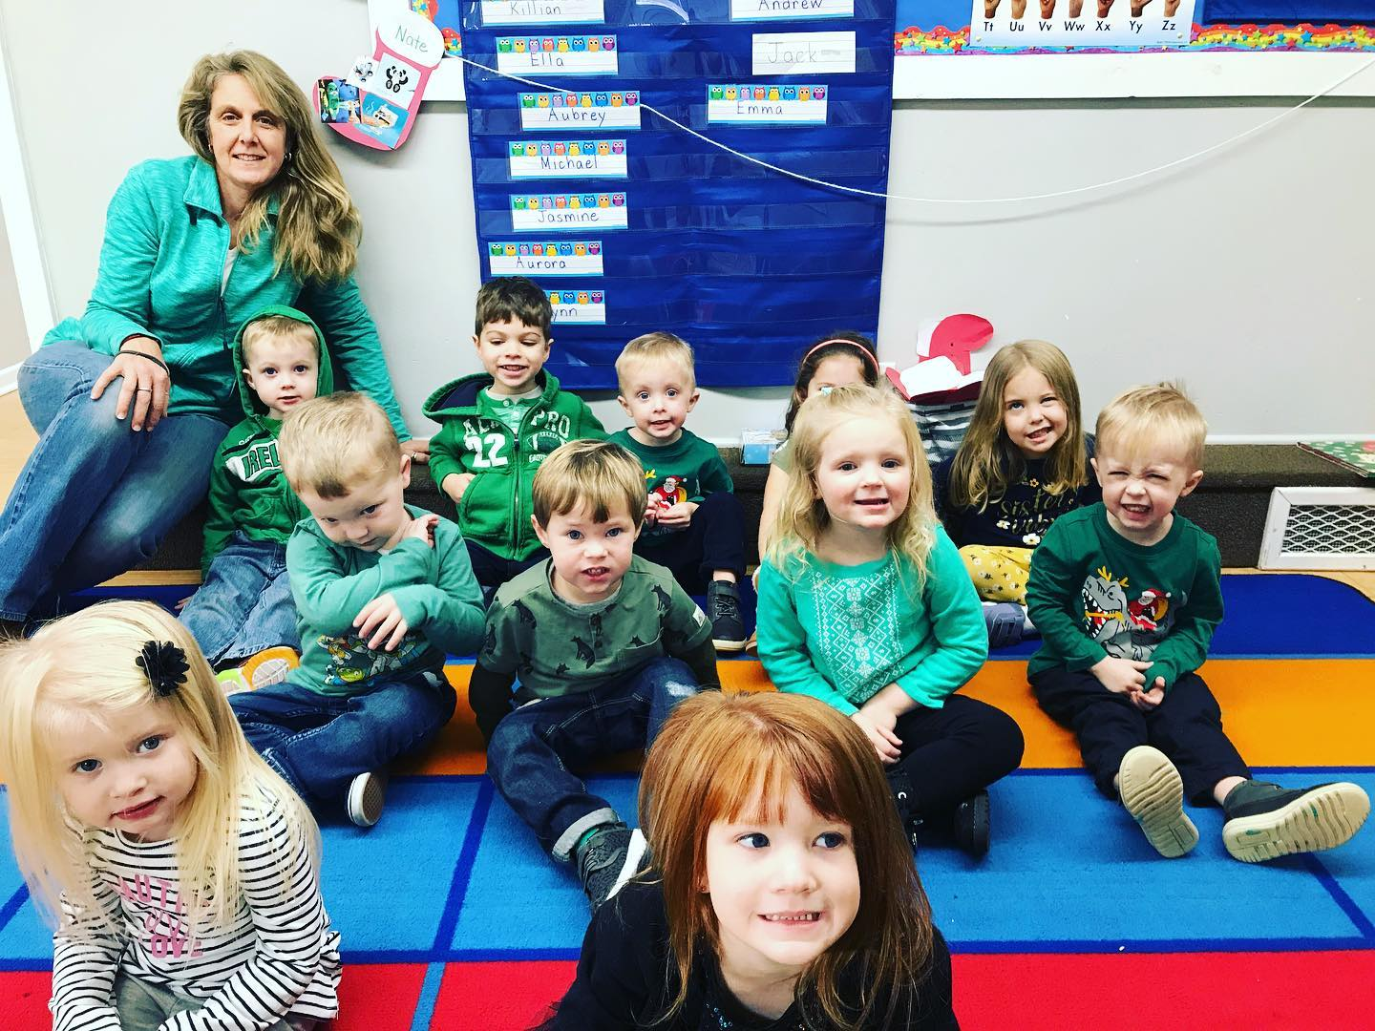
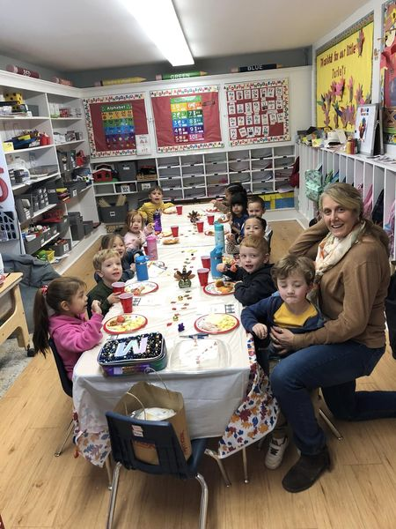
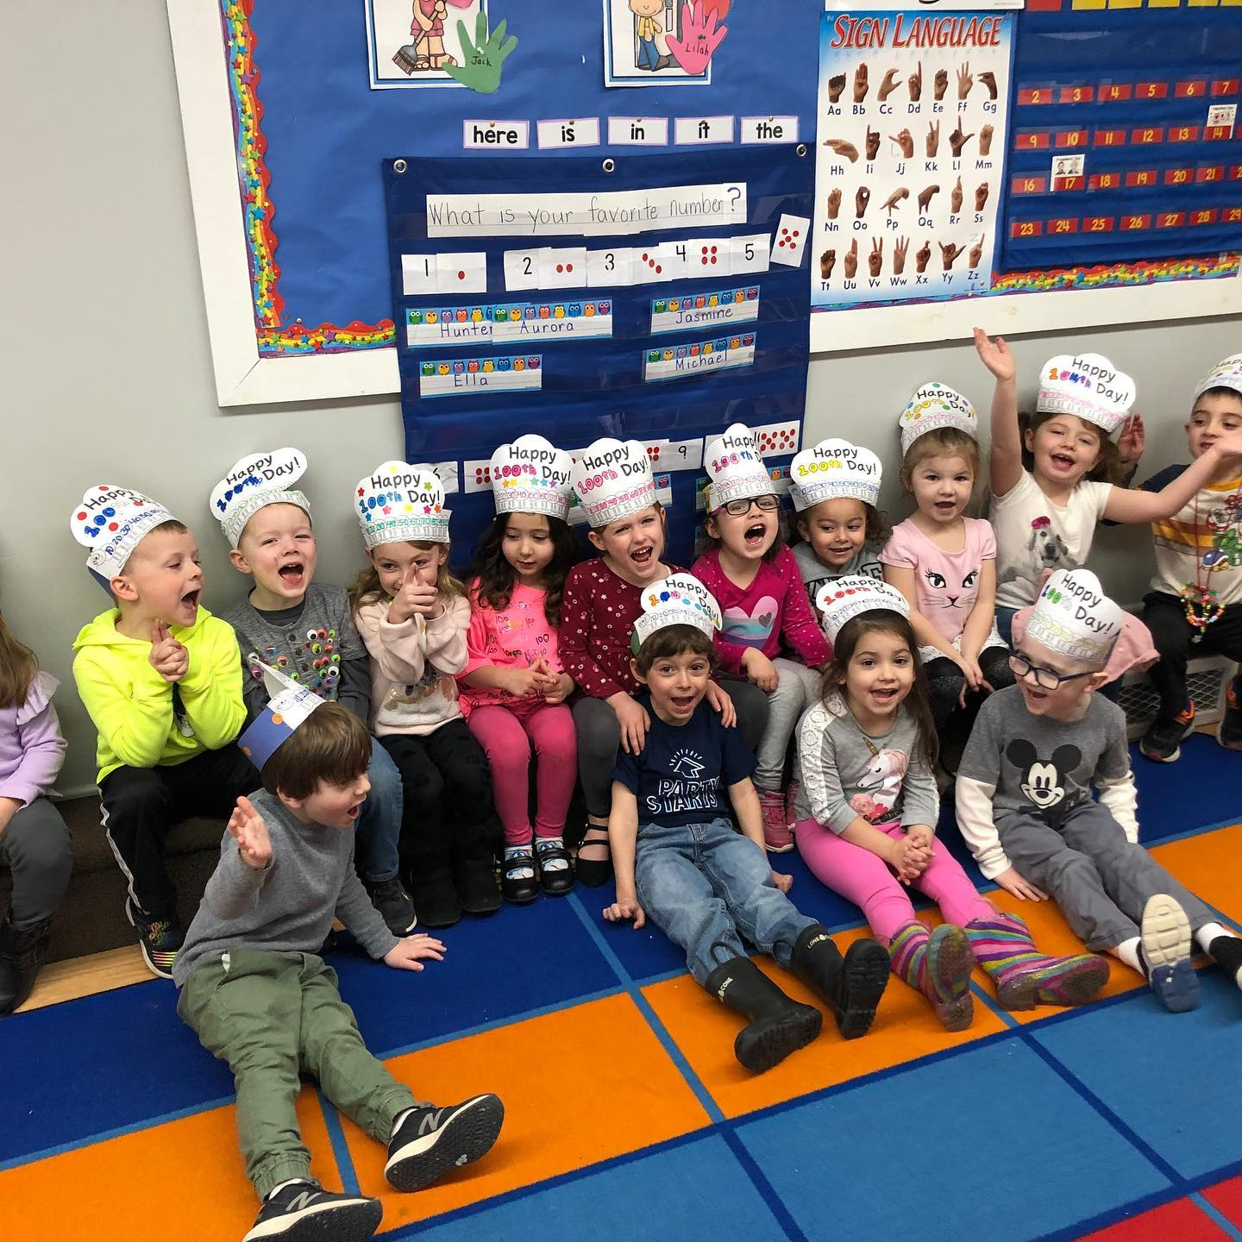
Half Day UPK Schedule
AM Class
9:00-9:10 Arrival, question of the day
9:10-9:40 Circle Time -This includes intro of thematic unit, letter, number, shape and color mini-lesson, calendar, weather, movement, songs
9:40-10:10 Outside Playtime
handwashing, snack outside if weather permitting.
10:10-10:30 snack,book looking or writing packet,Storytime/Discussion
Directions for small group instruction.
10:30-11:20 Whole Group Art, Math, or Literacy activity. Then small Group Instruction/Centers.This will include phonics, math, science, journal writing, art projects, and fine motor activities. Centers/play areas using watercolors, playdough, legos, kitchen, blocks, puppets, etc.
11:20-11:30 Sharing Time/Dismissal Procedure
PM Class
12:30-12:40 Arrival, question of the day
12:40-1:00 Circle Time -This includes intro of thematic unit, letter, number, shape and color mini-lesson, calendar, weather, movement, songs
1:00-1:40 Center Time-Dramatic Play, Art, Music, Writing, ABC, Fine Motor, Math & Science (small group instruction during this time)
1:40-2:00 Snack, book looking or writing packet when finished.Storytime/Discussion
Directions for whole group instruction.
2:05-2:30 Whole Group Art, Math, or Literacy activity.
2:30-2:50 Outdoor playtime
2:50-3:00 Sharing Time/Dismissal Procedure

Slide 11
Full Day UPK Year at-a-Glance
September-Welcome to School
All About Me
Friends/Families
Apples
Letters-A,F
Shape-Circle
Color-Red
Numbers-1,2
October- Fall/Leaves/Pumpkins/Spiders
Letters-L,S,M
Shape-Square
Color-Orange
Numbers-3,4
November-Dinosaurs/Transportation/ Thanksgiving/Being Thankful
Letters-D,T,Y
Shape-Triangle
Color-Yellow
Numbers-5,6
December-Gingerbread Men/Hibernation/Winter/ Christmas
Letters-G,H,W
Shape-Star
Colors-Green
Numbers-7,8
January-Water/Penguins/Polar Animals
Letters- I,P,J
Shape-Oval
Colors-Blue
Numbers-9,10
February-Bears/Valentine’s Day/Shadow
Letters-V, X, N
Shapes-Heart
Color-Pink
Numbers-11, 12
March-Weather(Lions & Lambs)/St. Patrick’s Day
Letters-C,U,K
Shape-Rectangle
Color-Gray
Numbers-13, 14
April-Easter/Earth Day/Space
Letters-E,O,R
Shapes-Hexagon
Color-Purple
Numbers-15,16
May- Mother’s Day/Flowers/
Zoo
Letters-Z, B, Q
Shape-pentagon
Color-purple
Numbers-17, 18
June- Circus/Summer/
Kindergarten
Letters-Review of all letters
Shape-Review
Numbers-19,20

Slide 12
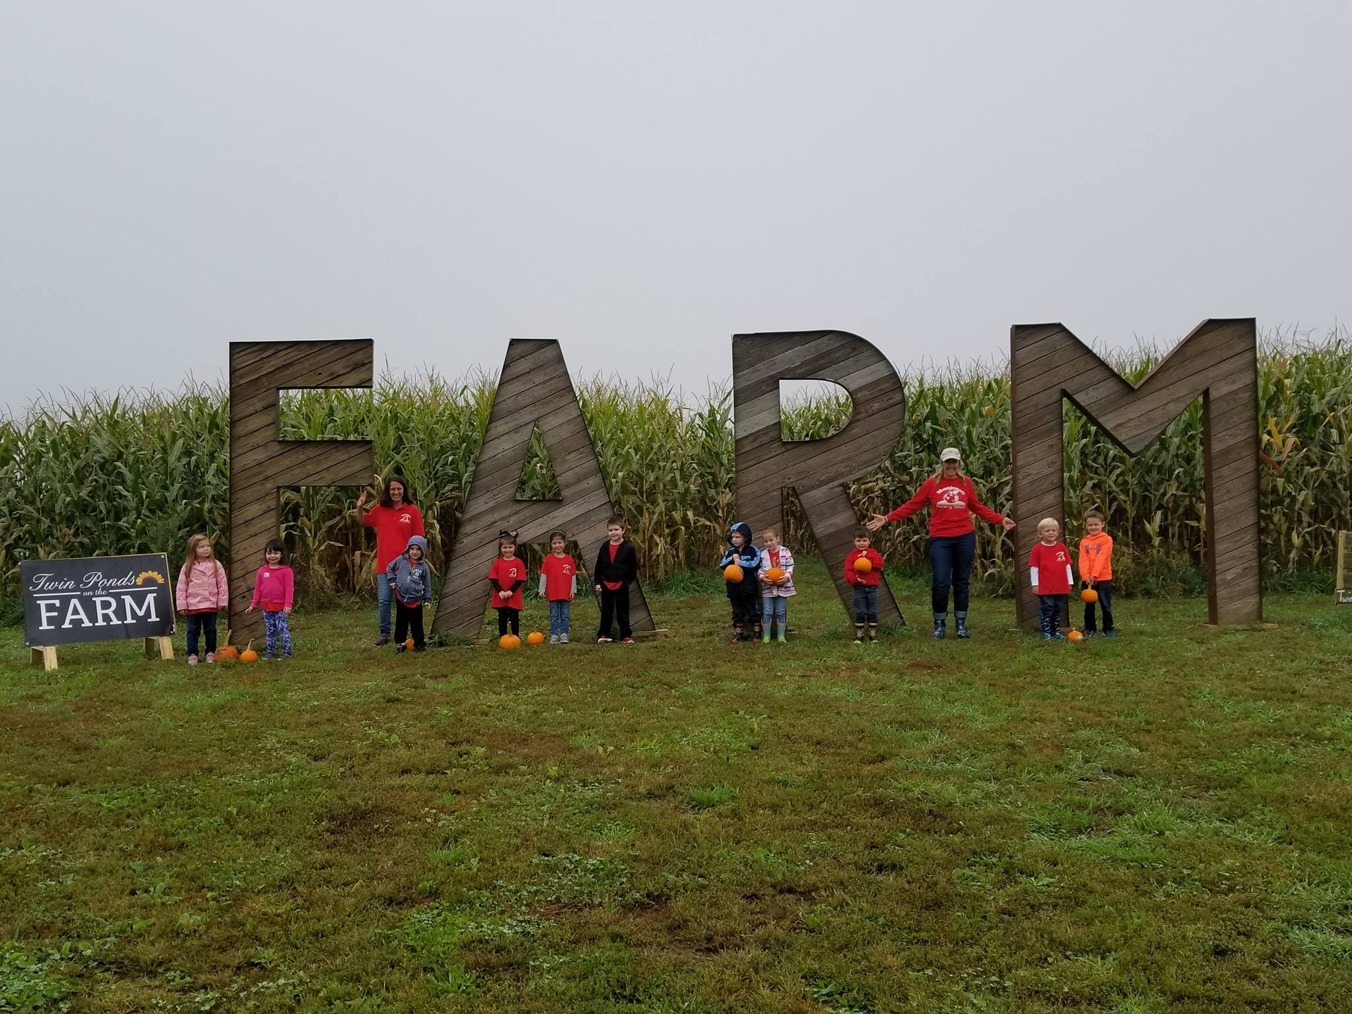
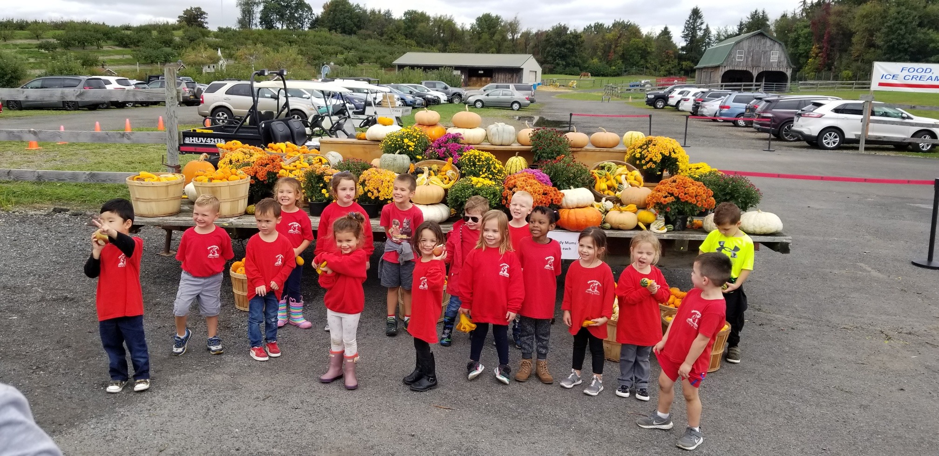
Full Day UPK Schedule
Schedule for Full Day Preschool *All children will start the day by washing their hands before entering the classroom.
Full Day UPK Schedule:
9:00-9:15- Unpack
9:15-9:45- Circle Time/Story Time
9:45-9:50- Hand Washing
9:50-10:10- Snack
10:10-10:40- Recess (Outdoor Free Play)
10:45-10:50- Hand Washing
10:50-11:30- Centers (Self-Selected Activities)
11:35-11:45- Cleanup/Handwashing
11:45-12:15- Lunch
12:15-12:30- Quiet Time
12:30-1:00- Recess (Outdoor Free Play)
1:00-1:10- Hand Washing
1:10-1:30- Small Group
1:30-2:30- Centers (Free Choice)
2:30-2:45- Special
2:45- Cleanup/Pack-up

Slide 13
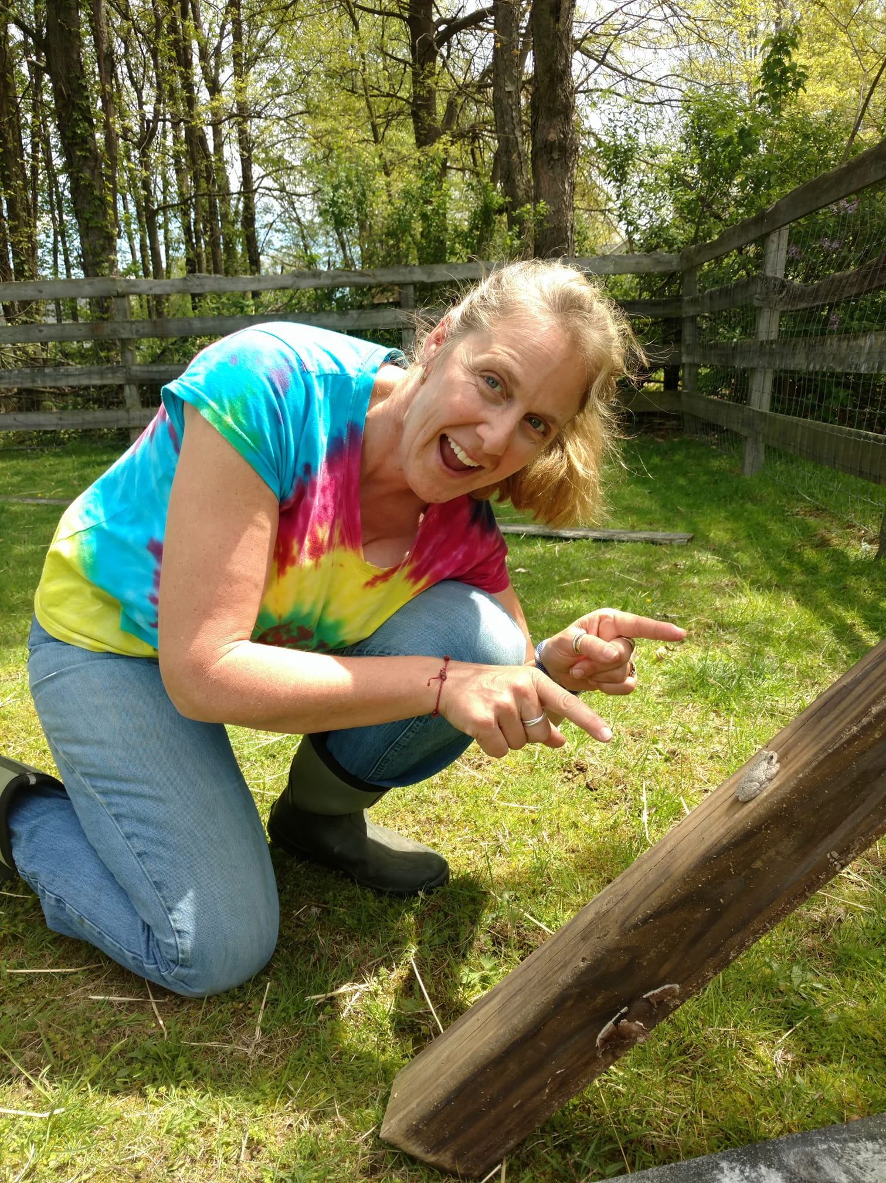
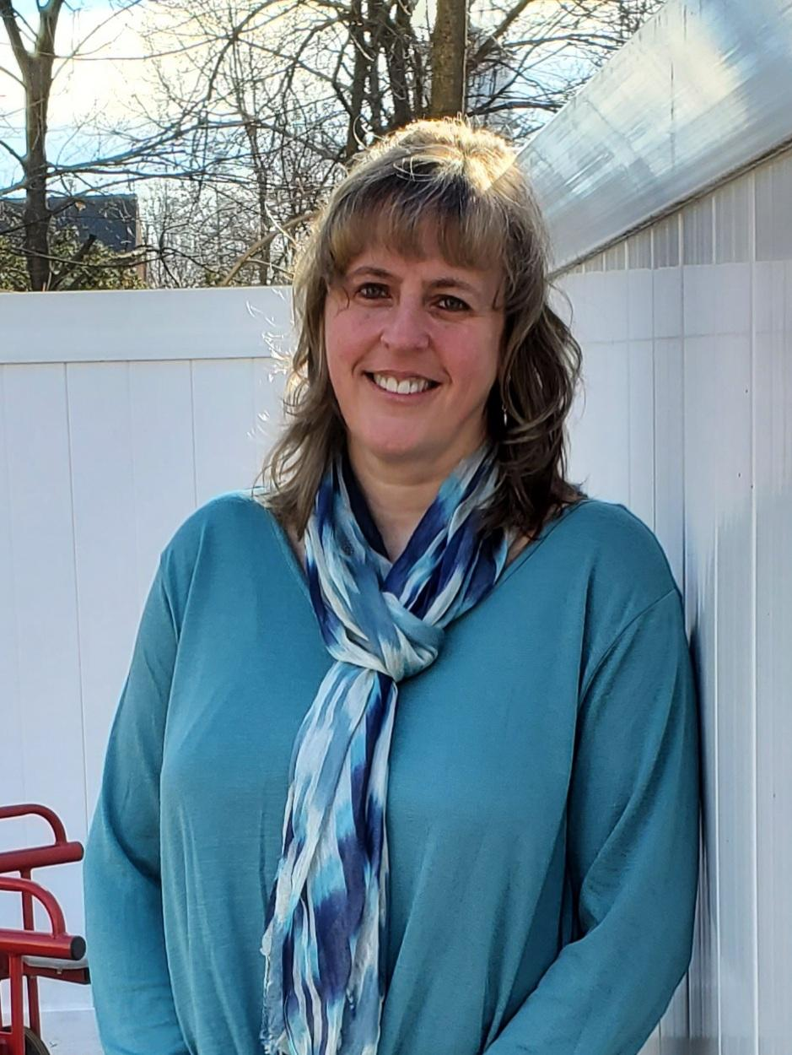
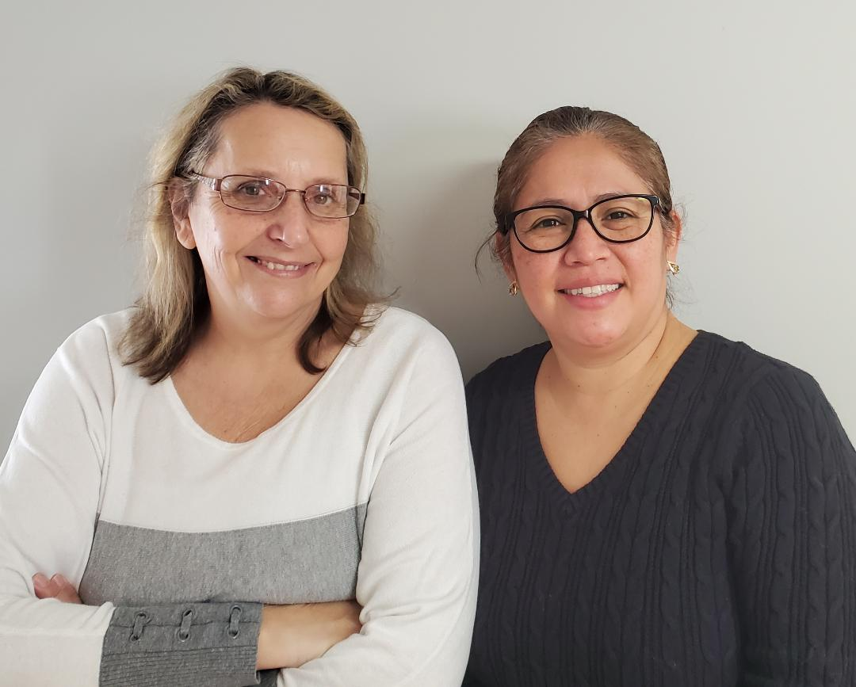
Virtual Tour of our Buildings
Red School: Three’s and Four’s Half Day (UPK)
Threes: https://www.youtube.com/watch?v=hr7L11xZoAs&feature=youtu.be
Fours: https://youtu.be/qqd5H_En-KM
White School: Four’s Full Day (UPK)
https://youtu.be/RYd5AozJ_Tw

Slide 14
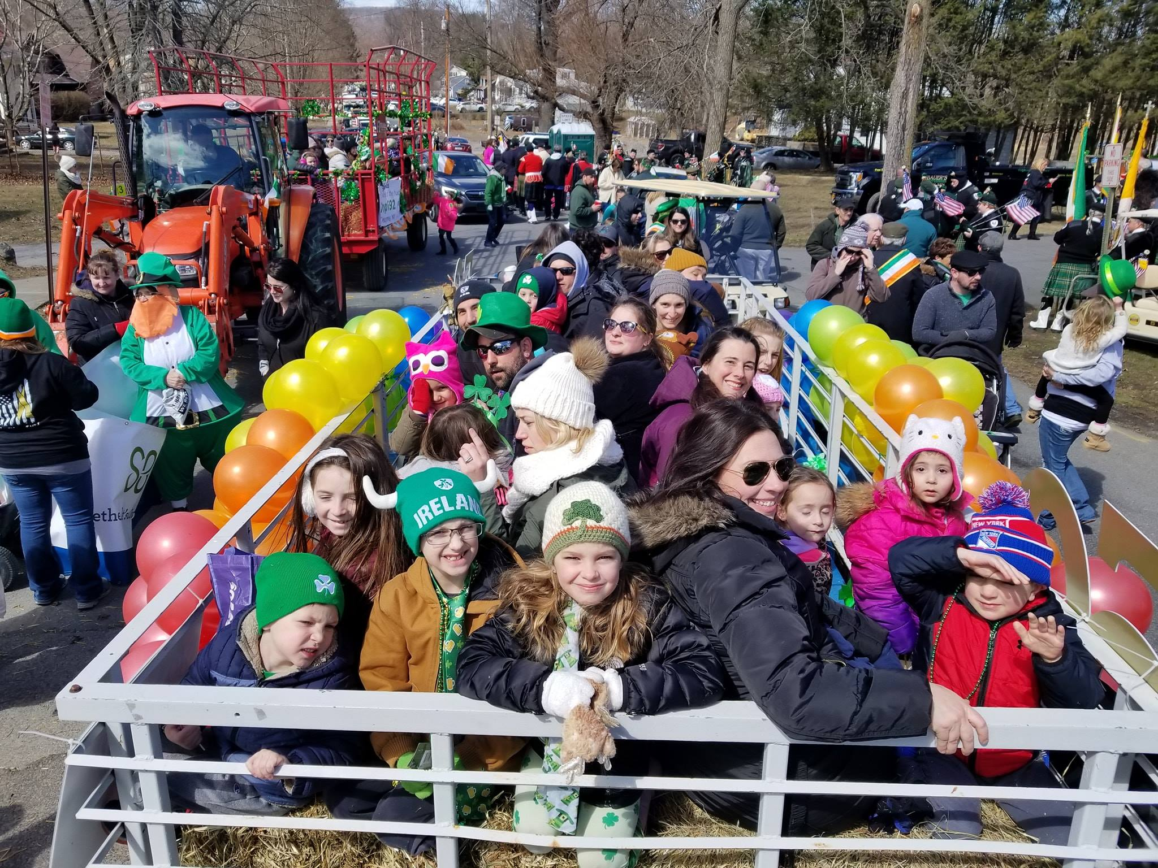
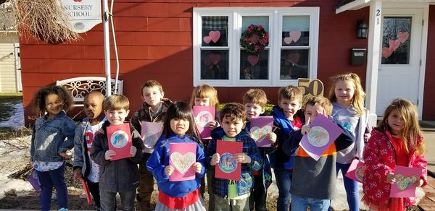
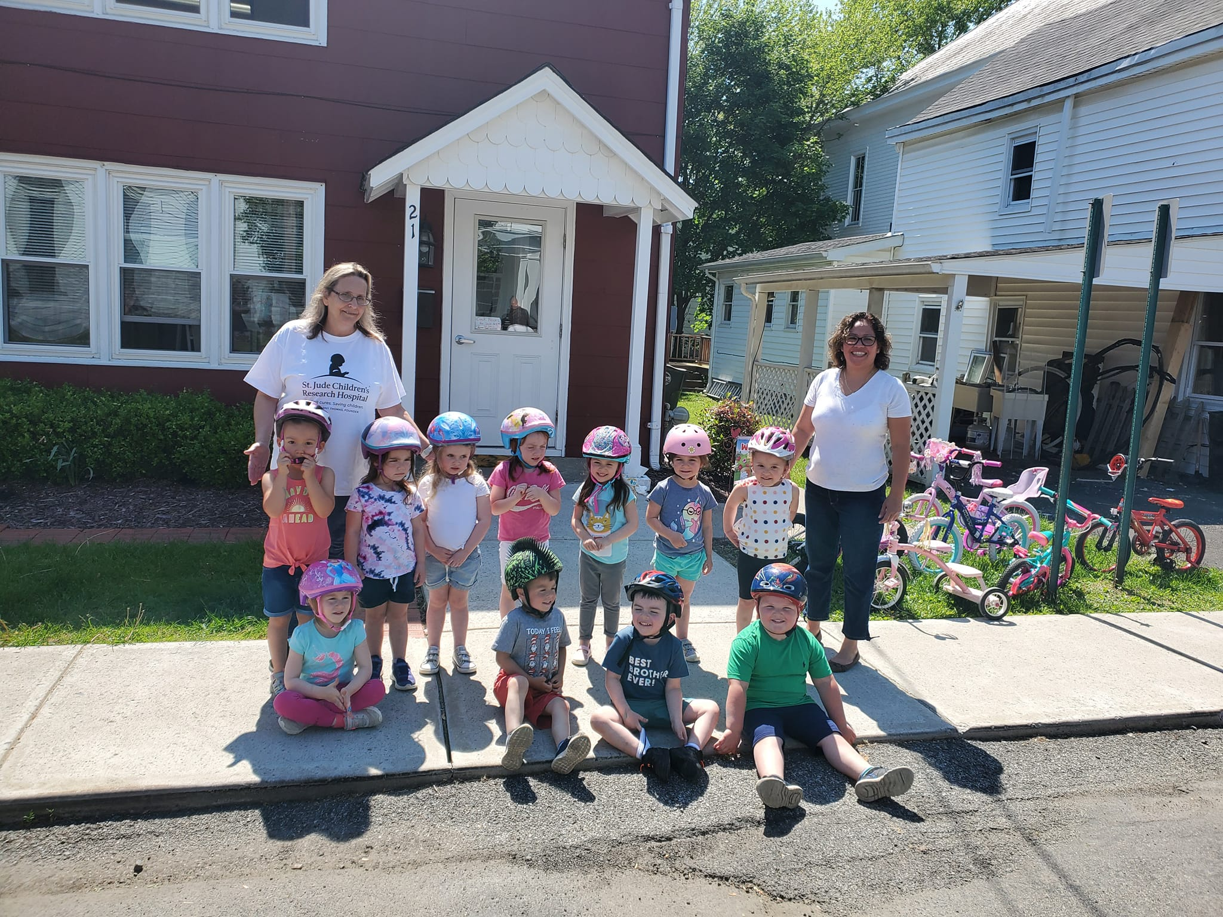
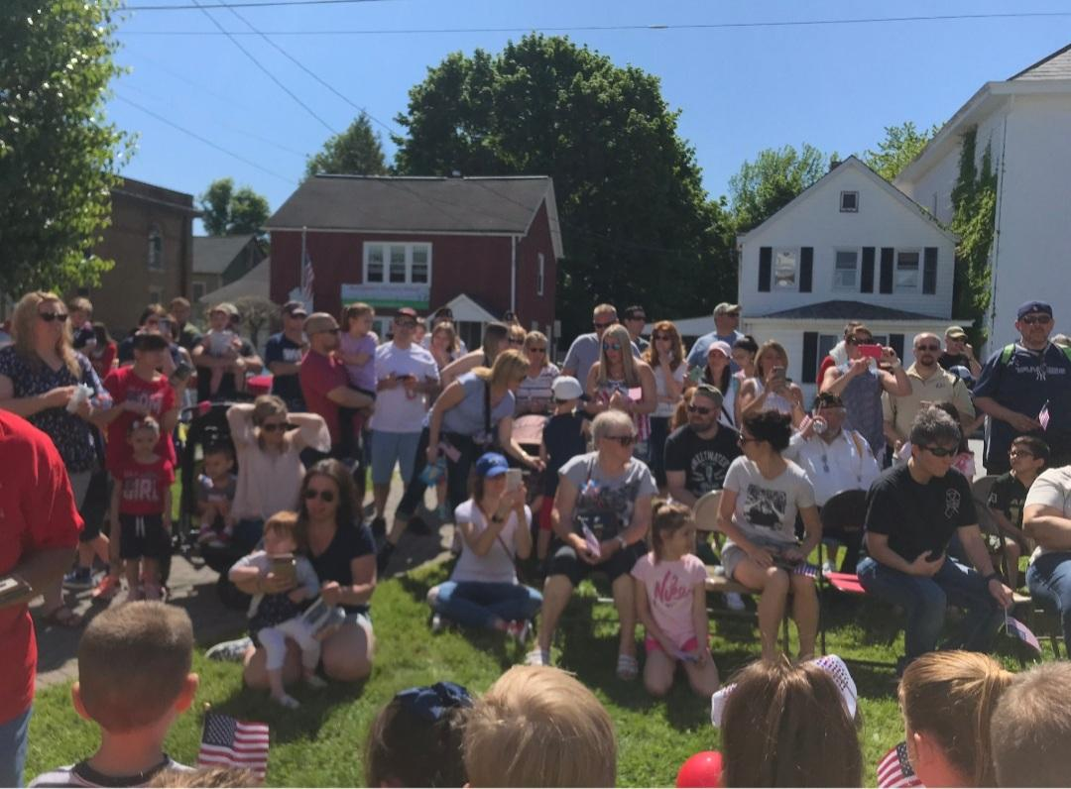
Fun Facts
Our school takes walking field trips around the Village to places like the library, the bank, the bakery, and the fire museum.
We go on field trips in the fall and spring to places like Twin Ponds and Lawrence Farms, and the Children’s Museum, Richard’s, Montgomery Elementary School, and the Park in the Village. (Of course, this year has been a little different.)
We like to participate in Village Events, including parades and celebrating our local Veterans.
Every year our Three’s participate in the St. Jude’s Trike-a-Thon
St. Patrick’s Day Parade
Valentine’s for Veterans
St. Jude’s Trike-a-Thon
Ceremony recognizing and honoring Veterans

Slide 15
Class Information
Mommy and Me Class
We offer a Mommy and Me class which meets once a week for 18 months – 3 years old and their caregiver.
Monday 9:30 – 10:30 am
3-Year-Old Class
Our Three-Year-Old’s class meets for 2 ½ hours each session in the Red School.
Tuesday & Thursday 9:15-11:45 am
Mon, Weds, & Friday 9:15-11:45 am
Monday-Friday 9:15-11:45 am
4-Year-Old Class – 5 Days UPK HALF DAY (anticipated)***
Our Four-Year-Old half day class meets five times a week for 2 ½ hours each session in our Red School. As a collaborative agency of VCSD (anticipated) any child selected for this program and placed at our school can be placed in either morning or afternoon sessions.
Monday through Friday 9:00-11:30 am
Monday through Friday 12:30-3:00 pm
4-Year-Old Class – 5 Days UPK FULL DAY (anticipated)***
Offered as a collaborative agency of VCSD UPK (anticipated) our four-year-old full day class meets five times a week for 6 hours in our White School (the First Presbyterian Church across the street from the Red School).
Monday through Friday 9:00am-3:00 pm

Slide 16

Tuition
Tuition for the 2025-2026 school year is:
Mommy & Me (7 week session) $160
3 year old class (2 day) $200 per month
3 year old class (3 day) $300 per month
3 year old class (5 day) $500 per month
4 year old class HALF (5 day) $500 per month
*UPK students selected through the Valley Central lottery do not pay tuition, the District is responsible

Slide 17
Before and After Care
We offer Before and After Care Before care to students starting at 8:00 am until the start of class. After care runs from the end of class at 3 pm until 4:30 pm. Both services are $8.00 per half hour. Before and After Care for the 2025-2026 school year is tentative and will be based on guidelines and interest.

Slide 18
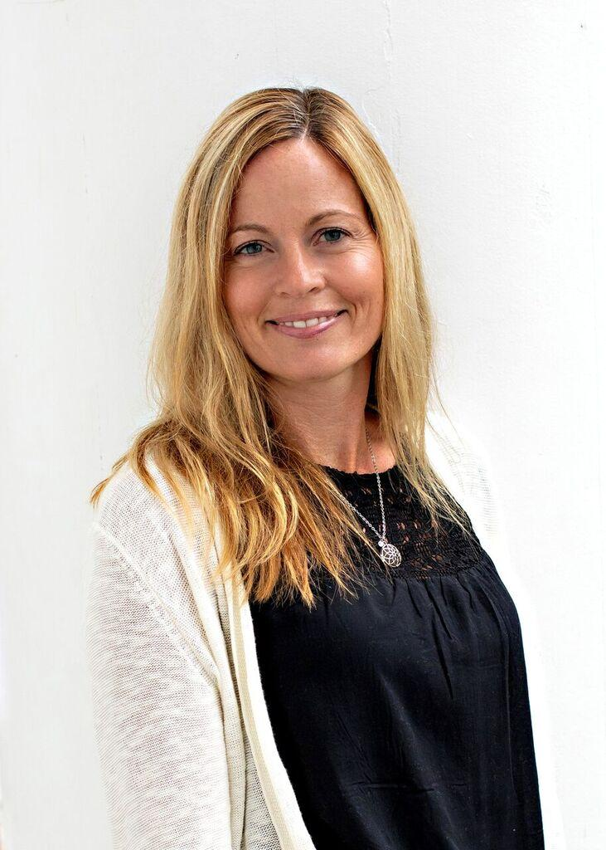
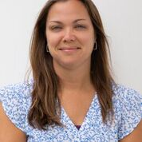
Board of Directors
Director of Student & Teacher Services
Tory White
Director of Administrative Services
Marie Moore
Chairperson
Janice Kelly
Board Members
Pat Pskowski
Stacy Piracci
Jamie Amaro
Katie Plitsch
Katie Bastien

Slide 19

Questions?
Contact us:
Web site: www.MontgomeryNurserySchool.org
Email: mnsregistration@yahoo.com
FaceBook: https://www.facebook.com/Montgomery-Nursery-School-434616766580748
Instagram: https://www.instagram.com/explore/locations/677515649/montgomery-nursery-school/

